Slide 1
ECON 411 Public Sector Economics PowerPoint Material 2020
J. Fred Giertz
Institute of Government and Public Affairs and Department of Economics
University of Illinois at Urbana

Slide 3
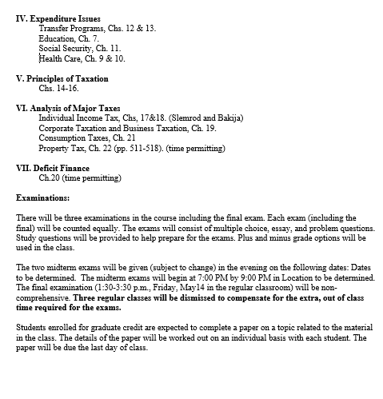

Slide 4
Public Sector Economics
What is the class about?
Public finance, public sector economics, public economics, and public choice
Definition of Economics: unlimited wants and scarcity--necessity of choice
Inclusiveness of definition--environment, crime, etc.
Micro vs. macro
This course largely micro, impact of government on allocative decisions (excluding regulation)--some macro involving fiscal policy choices and debt, economic growth
Approach:
The role of government in a basically private enterprise economy.
Role and evaluation of market vs. role and evaluation of government--Market failure and government failure
View of government: non-organic
Public choice approach--maximizing behavior extended to public sector activities
Which approach explains better? Private maximizing vs. benevolent
Can you assume that government intervention necessarily improves outcomes
Example of voting--school finance issue

Slide 5
Short On-Line Lectures
Circular Flow of Market Economy (Khan Academy):
https://www.khanacademy.org/economics-finance-domain/macroeconomics/gdp-topic/circular-econ-gdp-tutorial/v/circular-flow-of-income-and-expenditures
Supply and Demand (Khan Academy):
https://www.khanacademy.org/economics-finance-domain/microeconomics/supply-demand-equilibrium
Economic Efficiency (Khan Academy):
https://www.khanacademy.org/economics-finance-domain/microeconomics/consumer-producer-surplus/deadweight-loss-tutorial/a/demand-supply-and-efficiency-cnx
Consumer and Producer Surplus (Khan Academy)
https://www.khanacademy.org/economics-finance-domain/microeconomics/consumer-producer-surplus/consumer-producer-surplus-tut
Public Goods and Externalities
https://www.khanacademy.org/economics-finance-domain/microeconomics/consumer-producer-surplus/externalities-topic/a/public-goods-cnx
Public Choice
Cyclical Majority I and Cyclical Majority II, Median Voter Theorem, Median Voter Example

Slide 6
Role of the Market
Decentralized system can lead to desirable results
Economic efficiency
Maximizing net benefits
Consumer and producer surpluses
Economic equilibrium
Coincidence of equilibrium and efficiency
Examples of inefficiency
Equity

Slide 7
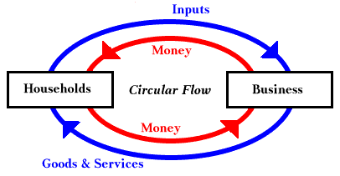

Slide 8
Possible Problems with Market (What is the role government in a private enterprise economy?)
Preconditions for functioning market
Property rights
Enforcement of contracts
Philosophical issues
Do consumers know what is best for them?
Can consumers make “rational” choices?
Technical issues
Public goods
Externalities
Incomplete Markets
Imperfect information–Asymmetric information
Distribution
Monopoly
Macro issues—stability and growth

Slide 9
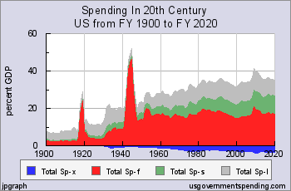
Size of Government-Growth of Spending
Technical reasons
Prices—deflate
Population-per capita
Income-% of GDP
Other
Wars-defense
Increase in transfers
(Transfer vs. exhaustive spending)
Baumol effect

Slide 10
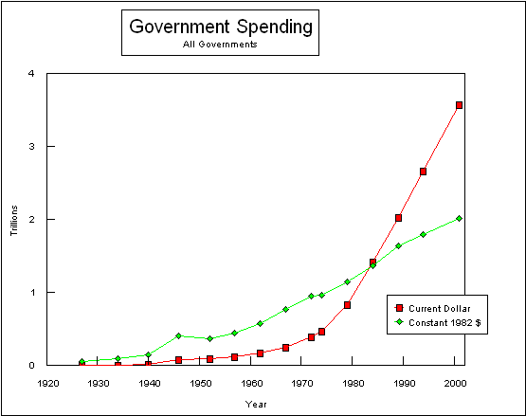

Slide 11
Evaluation of Market
Efficiency
Equity (fairness)

Slide 12
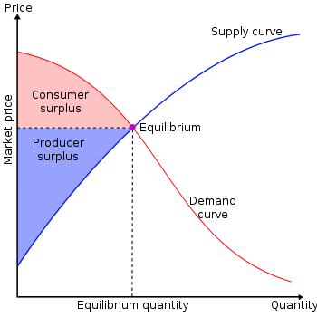
Review of Economic Efficiency and Market Equilibrium REVIEW
Marginal Cost
Marginal
Marginal Benefit

Slide 13
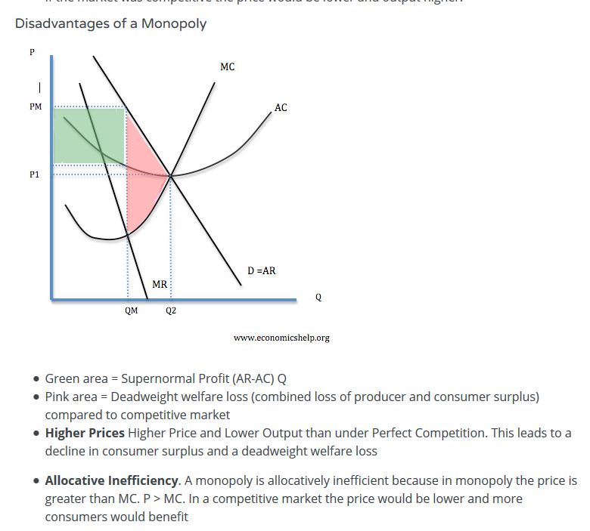
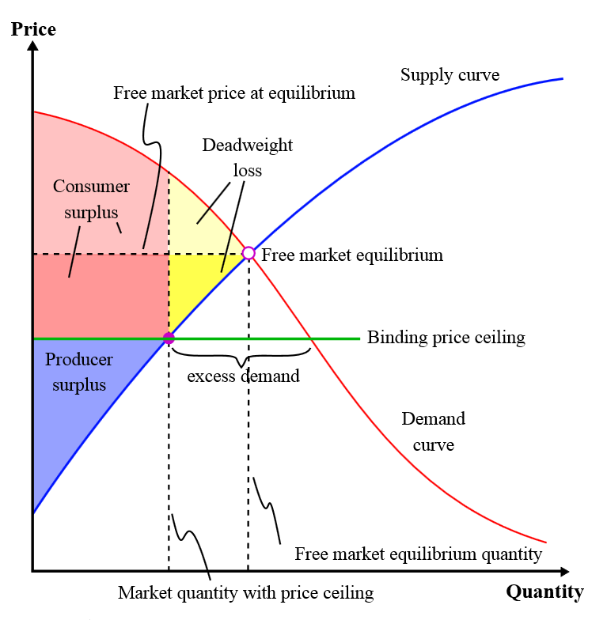
Examples of Inefficiency
Price Ceiling
http://www.economicshelp.org/microessays/markets/monopoly-diagram/

Slide 14
Public Goods in More Detail
Definition—contrast with private goods
Non-exclusion
Non-rivalry
Public goods vs. public production vs. public provision
Why does the market fail?
Free riding problems
Non-exclusion
Insignificance

Slide 15
Numerical example: Road shared by several people Private vs. public arrangements
Person Benefit Share
A 20
B 10
C 5
Sum 35
Person Benefit Share
A 12
B 12
C 11
Sum 35
Possible costs 15, 30,36

Slide 16
Efficiency and Equilibrium with a Private Good
Q1+Q2+Q3=Qtotal and MB1=MB2=MB3=MBtotal

Slide 17
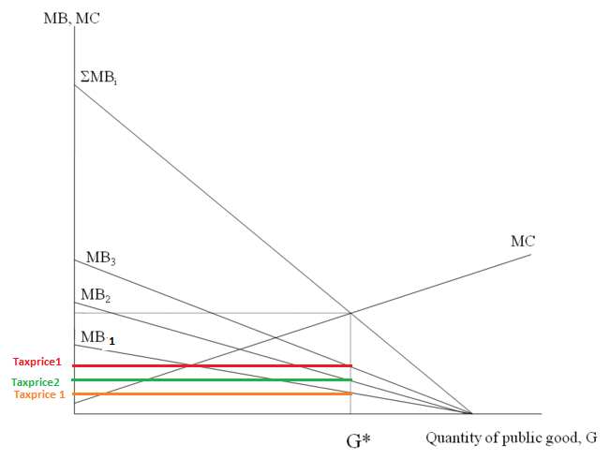
Efficiency with public goods
Q1=Q2=Q3=Qtotal and MB1+MB2+MB3=MBtotal

Slide 18
Unusual Public Goods and Free-riding Situations
Compulsory union membership
Donations to charities focusing on diseases
Membership in professional organizations
Problems in mutual defense arrangements
Problems faced by cartels
Overcoming problems: by-product (joint provision of public and provide goods)

Slide 19
Midterm Exam Information
The two midterm exams will be given (subject to change) in the evening on the following dates:
Thursday, March 5 and Tuesday, April 21. The midterm exams will begin at 7:00 PM by 9:00 PM in room 115 DKH.

Slide 20
Externalities in More Detail
Externalities defined
Negative such as pollution
Positive such as education
Why do they create problems for the market?
Social costs vs. private costs
Corrective actions
Are they needed?
What form should they take?

Slide 21
Externalities in More Detail
Externalities defined
Negative such as pollution
Positive such as education
Why do they create problems for the market?
Social costs vs. private costs
Private costs + external costs= social costs
Private benefits + external benefits= social benefits
Example of inefficiencies

Slide 22
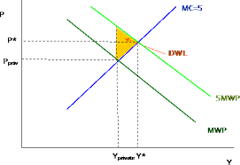
Externalities (continued)
Corrective actions
Are they needed? (Pigou vs. Coase)
What form should they take?
Regulations
Taxes and subsidies
A market for externalities

Slide 23
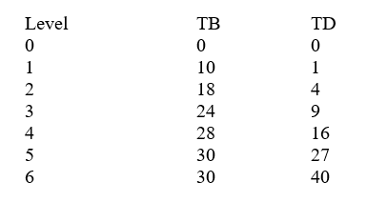
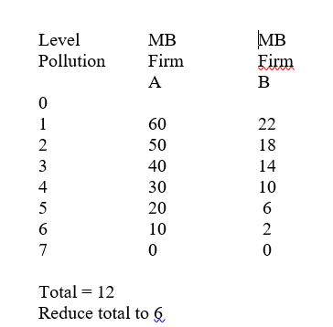
Coase Example
Cap and trade,
auctions, and
Pigovian Taxes

Slide 25
Public Choice
Constitutional Choice—deciding on the rules of the game
Why majority rule?
Decisionmaking costs vs. costs to losers
Decisions on ordinary issues
Problems with majority rule
Cyclical majority
Strategic behavior
Resolution of problems?
Median voter

Slide 26
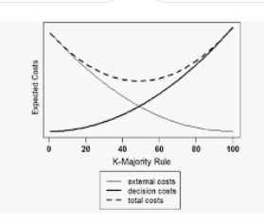
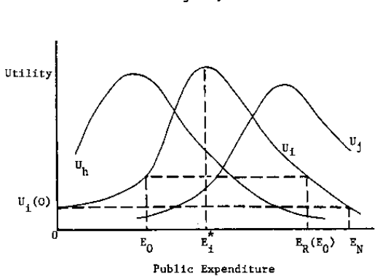
Constitutional Choice
and Majority Rule
Median Voter Outcome
Cyclical Majority Outcome

Slide 27
Non-single peaked preferences?
Public and private education
Strategic Voting-Pliny
1st 2cd 3rd
A a b d
B b a d
D d b a
a acquit
b banish
d death

Slide 28
Externalities in More Detail
Externalities defined
Negative such as pollution
Positive such as education
Why do they create problems for the market?
Social costs vs. private costs
Corrective actions
Are they needed?
What form should they take?

Slide 29
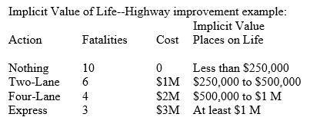
Benefit Cost Analysis
Specify objectives--benefits and costs
Measure output and costs in physical terms
Place a dollar value on b & c.
Compare with alternatives (discounting)

Slide 30
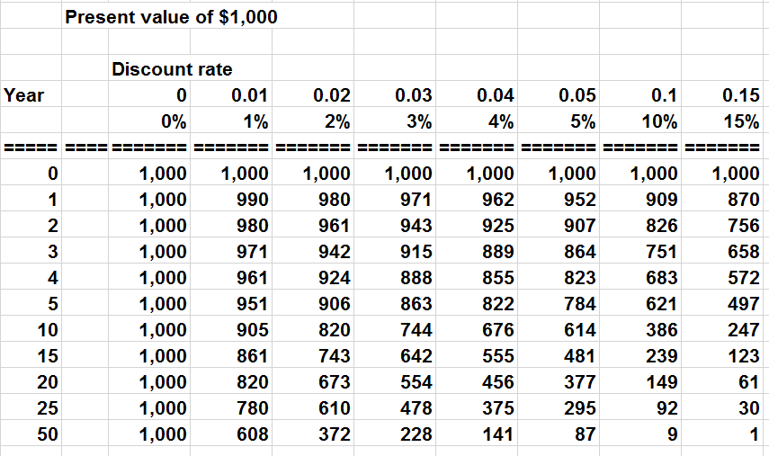
Benefit Cost Example

Slide 31
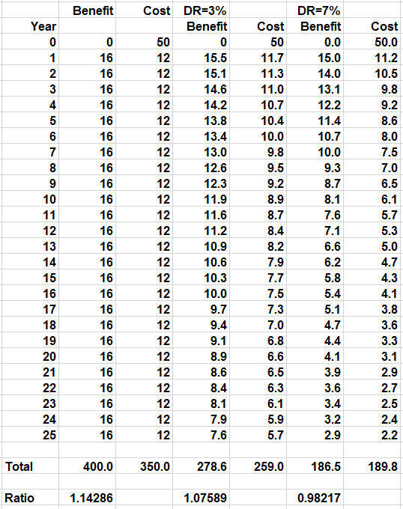
Importance of Discounting

