Slide 1
ECON 411
Public Sector Economics
PowerPoint Material
2020
J. Fred Giertz
Institute of Government and Public Affairs and Department of Economics
University of Illinois at Urbana

Slide 2
Short On-Line Lectures
Circular Flow of Market Economy (Khan Academy)
Supply and Demand (Khan Academy)
Economic Efficiency (Khan Academy)
Consumer and Producer Surplus (Khan Academy)
Public Goods and Externalities
Public Choice
Cyclical Majority I and Cyclical Majority II, Median Voter Theorem, Median Voter Example, Rent-seeking
Discounting
Time Value of Money, Present Value and Discounting (Khan Academy)
Redistribution
Income Inequality Negative Income Tax Earned Income Tax Credit
Asymmetric Information
Asymmetric Information, Moral Hazard, Adverse Selection in Health Insurance
Social Security Introduction

Slide 3
Short On-Line Lectures-continued
Introduction to Taxation—Lincoln Institute (Giertz) (You may need to register.)
http://leo.lincolninst.edu/course/view.php?id=12&sesskey=E2QITF8WG6
Tax Incidence (Khan Academy):
https://www.khanacademy.org/economics-finance-domain/microeconomics/consumer-producer-surplus/deadweight-loss-tutorial/v/taxation-and-dead-weight-loss
https://www.khanacademy.org/economics-finance-domain/microeconomics/consumer-producer-surplus/deadweight-loss-tutorial/v/taxes-and-perfectly-inelastic-demand
Regressive, Proportional and Progressive Taxes:
https://www.youtube.com/watch?v=0YhSlzpPr9U

Slide 4
Role of the Market
Decentralized system can lead to desirable results
Economic efficiency
  Maximizing net benefits
  Consumer and producer surpluses
Economic equilibrium
Coincidence of equilibrium and efficiency
Examples of inefficiency
Equity

Slide 5
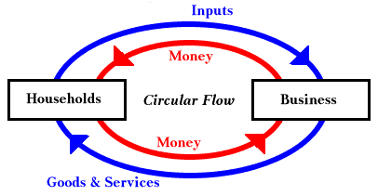

Slide 6
Possible Problems with Market
(What is the role government in a private enterprise economy?)
Philosophical issues
Technical issues
  Public goods
  Externalities
  Incomplete Markets
  Imperfect information–Asymmetric information
  Distribution
  Monopoly
  Macro issues—stability and growth

Slide 7
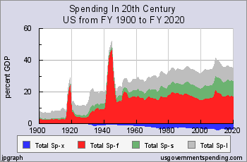
Size of Government-Growth of Spending
Technical reasons
  Prices
  Population
  Income
Other
  Wars-defense
  Increase in transfers
  (Transfer vs. exhaustive spending)
  Baumol effect

Slide 8
Evaluation of Market
Efficiency
Equity (fairness)

Slide 9
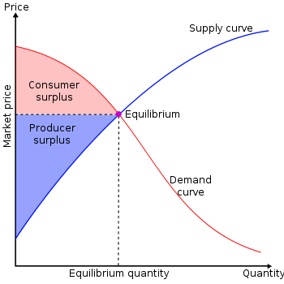
Review of Economic Efficiency and Market Equilibrium
REVIEW
Marginal Cost
Marginal
Marginal Benefit

Slide 10
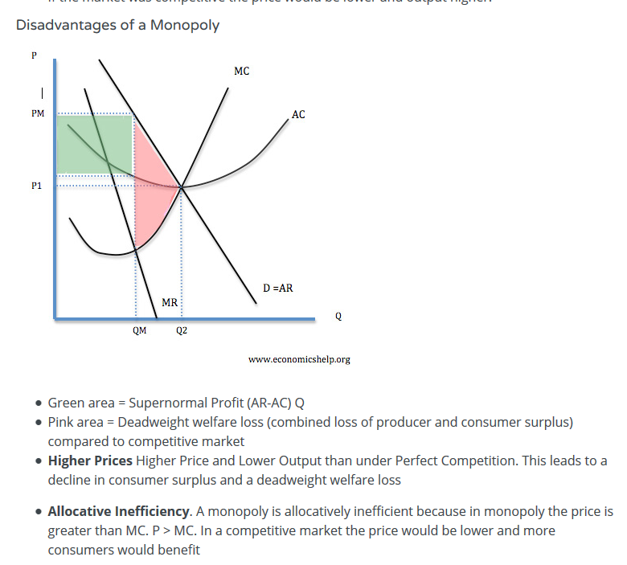
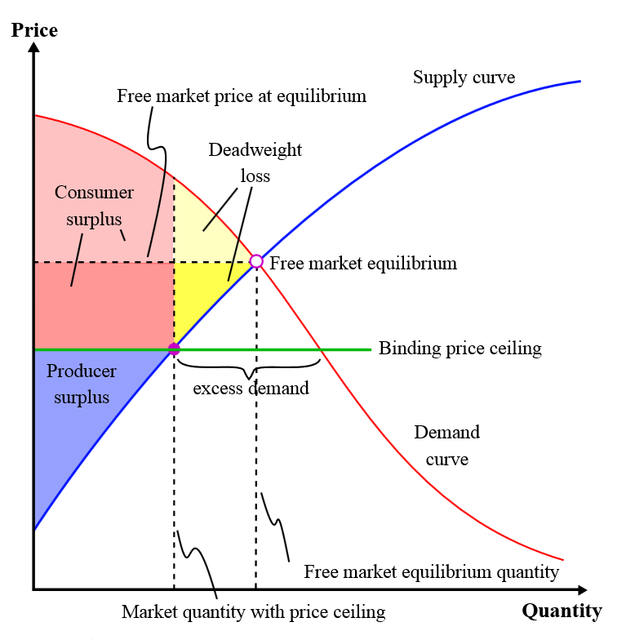
Examples of Inefficiency
Price Ceiling
http://www.economicshelp.org/microessays/markets/monopoly-diagram/

Slide 11
Public Goods in More Detail
Definition—contrast with private goods
  Non-exclusion
  Non-rivalry
Public goods vs. public production vs. public provision
Why does the market fail?
Free riding problems
  Non-exclusion
  Insignificance

Slide 12
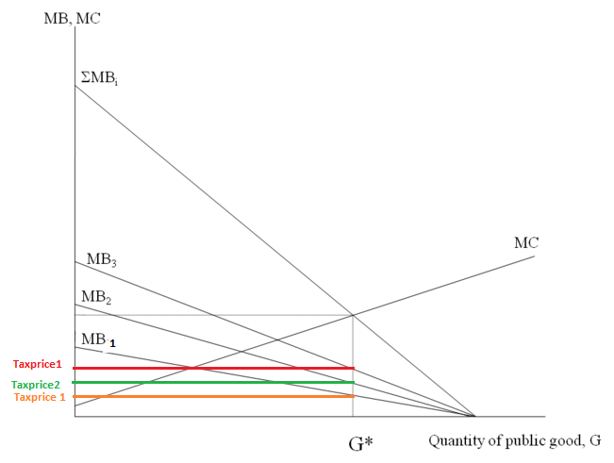
Efficiency with public goods

Slide 13
Externalities in More Detail
Externalities defined
  Negative such as pollution
  Positive such as education
Why do they create problems for the market?
Social costs vs. private costs
Corrective actions
  Are they needed?
  What form should they take?

Slide 14
Externalities in More Detail
Externalities defined
  Negative such as pollution
  Positive such as education
Why do they create problems for the market?
Social costs vs. private costs
  Private costs + external costs= social costs
  Private benefits + external benefits= social benefits
Example of inefficiencies

Slide 15
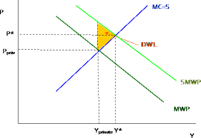
Externalities (continued)
Corrective actions
  Are they needed? (Pigou vs. Coase)
  What form should they take?
    Regulations
    Taxes and subsidies
A market for externalities

Slide 16
Public Choice
Constitutional Choice—deciding on the rules of the game
  Why majority rule?
  Decisionmaking costs vs. costs to losers
Decisions on ordinary issues
  Problems with majority rule
    Cyclical majority
    Strategic behavior
  Resolution of problems?
    Median voter

Slide 17
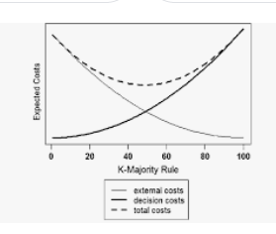
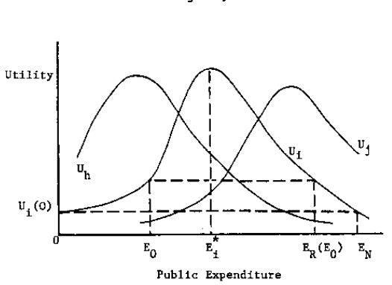
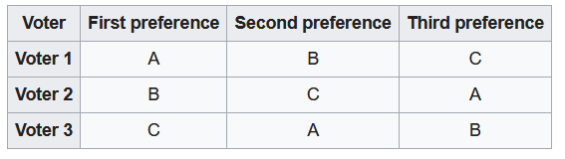
Constitutional Choice
and Majority Rule
Median Voter Outcome
Cyclical Majority Outcome

Slide 18
Non-single peaked preferences?
Public and private education
Strategic Voting-Pliny
1st 2cd 3rd
A a b d
B b a d
D d b a
a acquit
b banish
d death

Slide 19
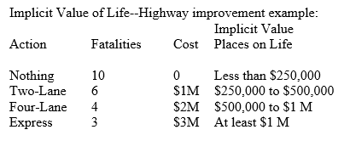
Benefit Cost Analysis
Specify objectives--benefits and costs
Measure output and costs in physical terms
Place a dollar value on b & c.
Compare with alternatives (discounting)

Slide 20
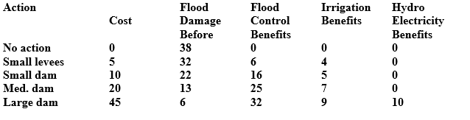
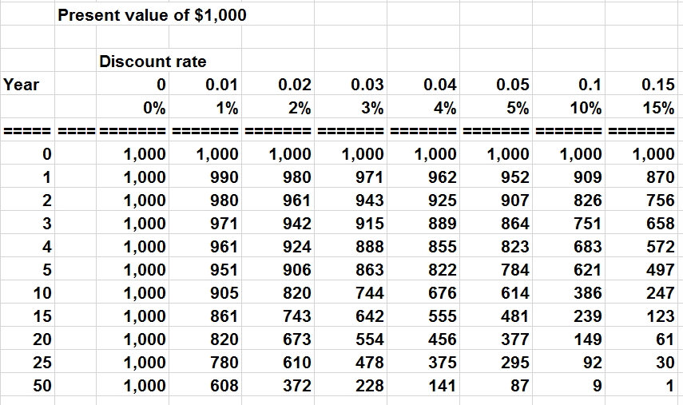
Benefit Cost Example

Slide 21
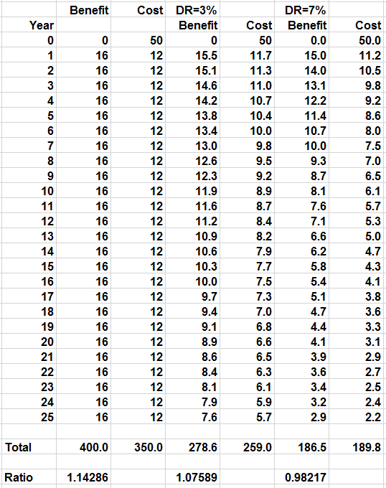
Importance of Discounting

Slide 22
ECON 411
Public Sector Economics
PowerPoint Material
2020
J. Fred Giertz
Institute of Government and Public Affairs and Department of Economics
University of Illinois at Urbana

Slide 23
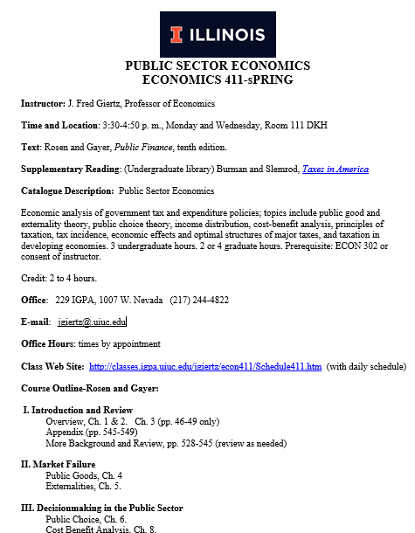

Slide 24
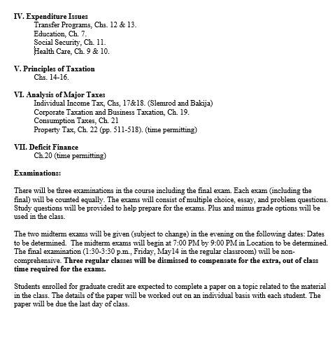

Slide 25
Public Sector Economics
What is the class about?
  Public finance, public sector economics, public economics, and public choice
Definition of Economics: unlimited wants and scarcity--necessity of choice
  Inclusiveness of definition--environment, crime, etc.
Micro vs. macro
  This course largely micro, impact of government on allocative decisions (excluding regulation)--some macro involving fiscal policy choices and debt, economic growth
Approach:
  The role of government in a basically private enterprise economy.
  Role and evaluation of market vs. role and evaluation of government--Market failure and government failure
  View of government: non-organic
  Public choice approach--maximizing behavior extended to public sector activities
  Which approach explains better? Private maximizing vs. benevolent
  Can you assume that government intervention necessarily improves outcomes
  Example of voting--school finance issue

Slide 26
Short On-Line Lectures
Circular Flow of Market Economy (Khan Academy):
https://www.khanacademy.org/economics-finance-domain/macroeconomics/gdp-topic/circular-econ-gdp-tutorial/v/circular-flow-of-income-and-expenditures
Supply and Demand (Khan Academy):
https://www.khanacademy.org/economics-finance-domain/microeconomics/supply-demand-equilibrium
Economic Efficiency (Khan Academy):
https://www.khanacademy.org/economics-finance-domain/microeconomics/consumer-producer-surplus/deadweight-loss-tutorial/a/demand-supply-and-efficiency-cnx
Consumer and Producer Surplus (Khan Academy)
https://www.khanacademy.org/economics-finance-domain/microeconomics/consumer-producer-surplus/consumer-producer-surplus-tut
Public Goods and Externalities
https://www.khanacademy.org/economics-finance-domain/microeconomics/consumer-producer-surplus/externalities-topic/a/public-goods-cnx
Public Choice
Cyclical Majority I and Cyclical Majority II, Median Voter Theorem, Median Voter Example

Slide 27
Role of the Market
Decentralized system can lead to desirable results
Economic efficiency
  Maximizing net benefits
  Consumer and producer surpluses
Economic equilibrium
Coincidence of equilibrium and efficiency
Examples of inefficiency
Equity

Slide 29
Possible Problems with Market
(What is the role government in a private enterprise economy?)
Preconditions for functioning market
  Property rights
  Enforcement of contracts
Philosophical issues
  Do consumers know what is best for them?
  Can consumers make “rational” choices?
Technical issues
  Public goods
  Externalities
  Incomplete Markets
  Imperfect information–Asymmetric information
  Distribution
  Monopoly
  Macro issues—stability and growth

Slide 30
Size of Government-Growth of Spending
Technical reasons
  Prices—deflate
  Population-per capita
  Income-% of GDP
Other
  Wars-defense
  Increase in transfers
  (Transfer vs. exhaustive spending)
  Baumol effect

Slide 31
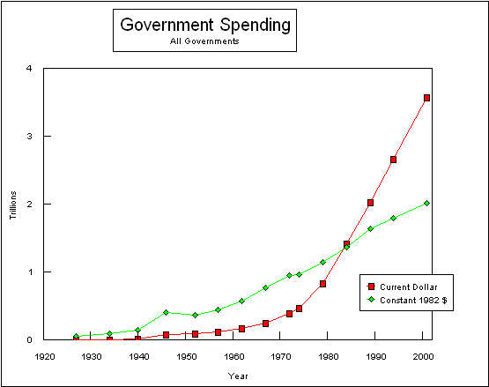

Slide 32
Evaluation of Market
Efficiency
Equity (fairness)

Slide 33
Review of Economic Efficiency and Market Equilibrium
REVIEW
Marginal Cost
Marginal
Marginal Benefit

Slide 34
Examples of Inefficiency
Price Ceiling
http://www.economicshelp.org/microessays/markets/monopoly-diagram/

Slide 35
Public Goods in More Detail
Definition—contrast with private goods
  Non-exclusion
  Non-rivalry
Public goods vs. public production vs. public provision
Why does the market fail?
Free riding problems
  Non-exclusion
  Insignificance

Slide 36
Numerical example:
Road shared by several people
Private vs. public arrangements
Person Benefit Share
A 20
B 10
C 5
Sum 35
Person Benefit Share
A 12
B 12
C 11
Sum 35
Possible costs 15, 30,36

Slide 37
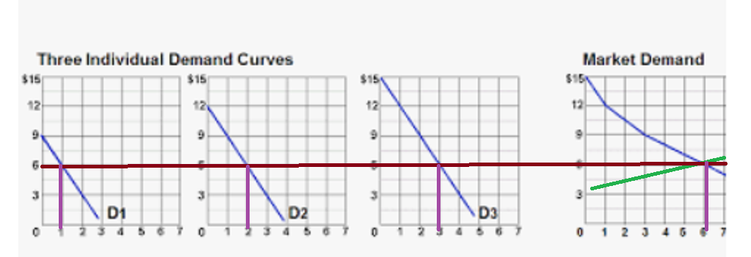
Efficiency and Equilibrium with a Private Good
Q1+Q2+Q3=Qtotal and MB1=MB2=MB3=MBtotal

Slide 38
Efficiency with public goods
Q1=Q2=Q3=Qtotal and MB1+MB2+MB3=MBtotal

Slide 39
Unusual Public Goods and
Free-riding Situations
Compulsory union membership
Donations to charities focusing on diseases
Membership in professional organizations
Problems in mutual defense arrangements
Problems faced by cartels
Overcoming problems: by-product (joint provision of public and provide goods)

Slide 40
Midterm Exam Information
The two midterm exams will be given (subject to change) in the evening on the following dates:
Thursday, March 5 and Tuesday, April 21. The midterm exams will begin at 7:00 PM by 9:00 PM in room 115 DKH.

Slide 41
Externalities in More Detail
Externalities defined
  Negative such as pollution
  Positive such as education
Why do they create problems for the market?
Social costs vs. private costs
Corrective actions
  Are they needed?
  What form should they take?

Slide 42
Externalities in More Detail
Externalities defined
  Negative such as pollution
  Positive such as education
Why do they create problems for the market?
Social costs vs. private costs
  Private costs + external costs= social costs
  Private benefits + external benefits= social benefits
Example of inefficiencies

Slide 43
Externalities (continued)
Corrective actions
  Are they needed? (Pigou vs. Coase)
  What form should they take?
    Regulations
    Taxes and subsidies
A market for externalities

Slide 44
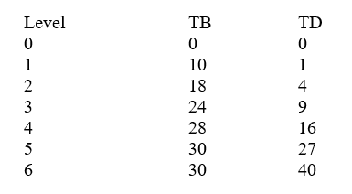
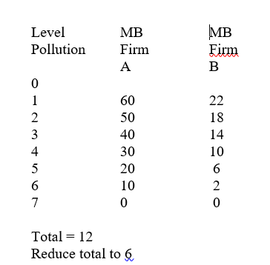
Coase Example
Cap and trade,
auctions, and
Pigovian Taxes

Slide 45
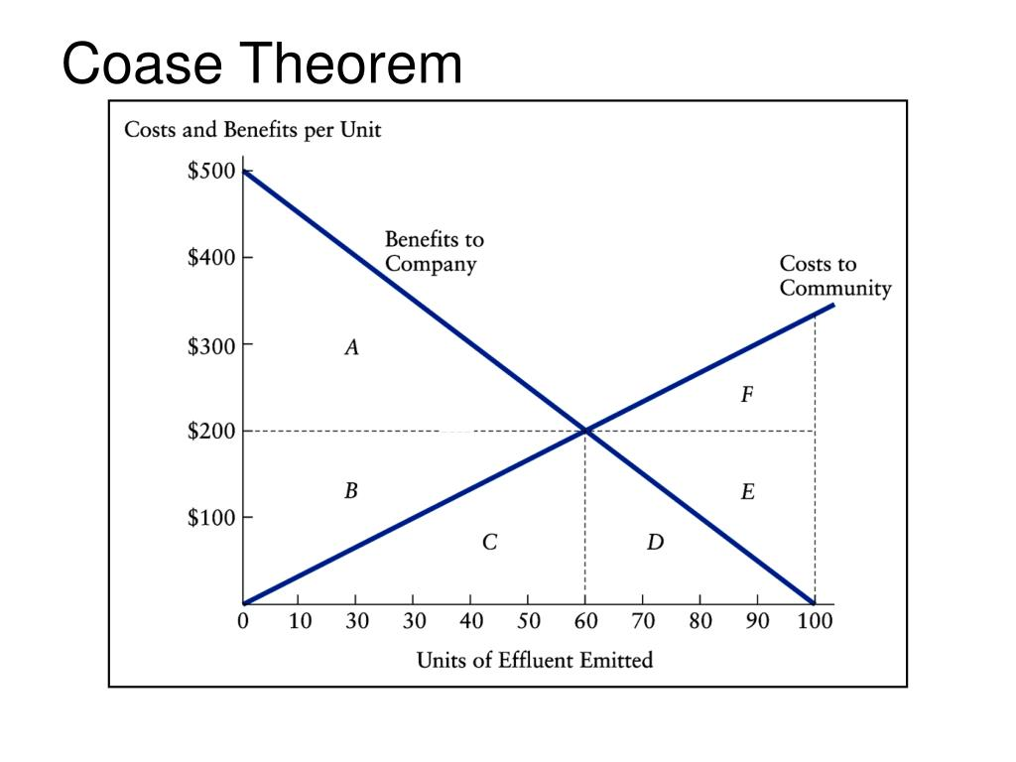

Slide 46
Public Choice
Constitutional Choice—deciding on the rules of the game
  Why majority rule?
  Decisionmaking costs vs. costs to losers
Decisions on ordinary issues
  Problems with majority rule
    Cyclical majority
    Strategic behavior
  Resolution of problems?
    Median voter

Slide 47
Constitutional Choice
and Majority Rule
Median Voter Outcome
Cyclical Majority Outcome

Slide 48
Non-single peaked preferences?
Public and private education
Strategic Voting-Pliny
1st 2cd 3rd
A a b d
B b a d
D d b a
a acquit
b banish
d death

Slide 49
Externalities in More Detail
Externalities defined
  Negative such as pollution
  Positive such as education
Why do they create problems for the market?
Social costs vs. private costs
Corrective actions
  Are they needed?
  What form should they take?

Slide 50
Benefit Cost Analysis
Specify objectives--benefits and costs
Measure output and costs in physical terms
Place a dollar value on b & c.
Compare with alternatives (discounting)

Slide 51
Benefit Cost Example

Slide 52
Importance of Discounting

Slide 53
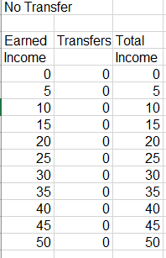
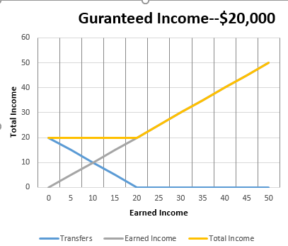
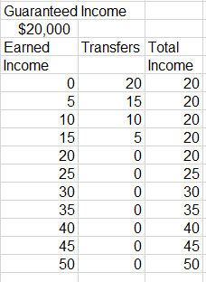
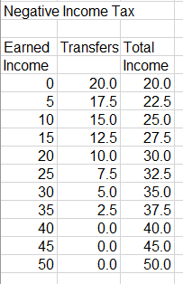
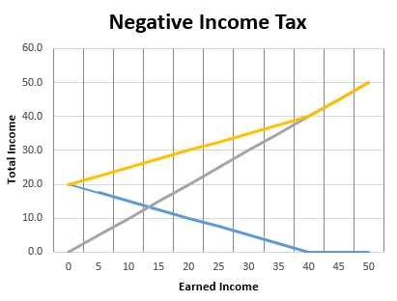
Income Transfer Options

Slide 54
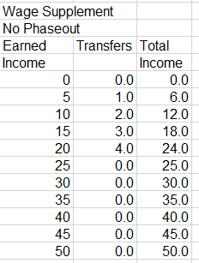
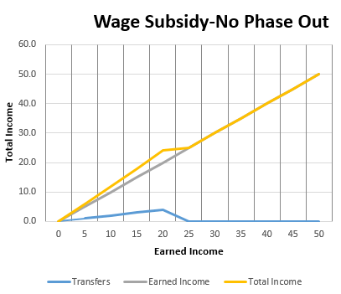
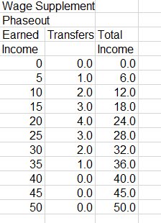
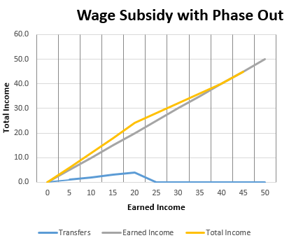
Income Transfer Options (continued)

Slide 55
Why is health care different?
Third party payers
Moral hazard problems
Adverse selection and asymmetric information problems (lemons)
Principal-agent problem–information and access to treatment options
Compare incentives in indemnity (fee-for-service) and HMO plans
Rapid technical advance
Presumption that everyone should have care–full access

Slide 56
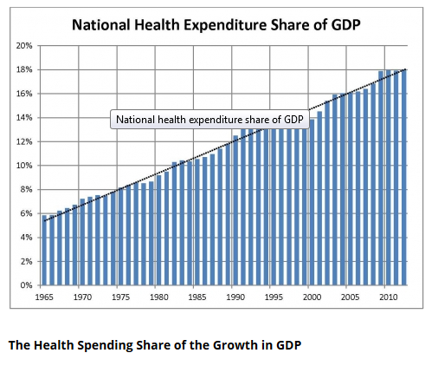
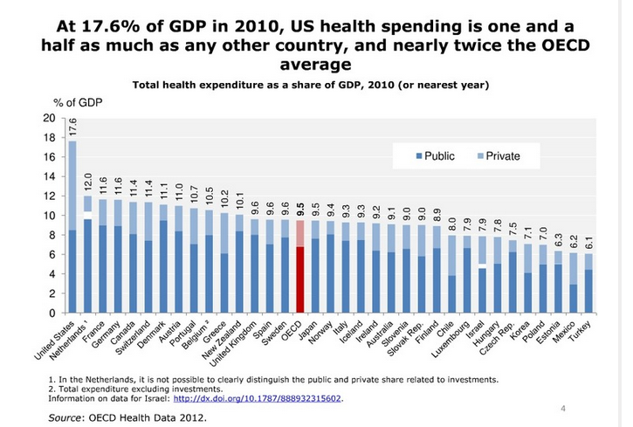
Health Care Spending

Slide 57
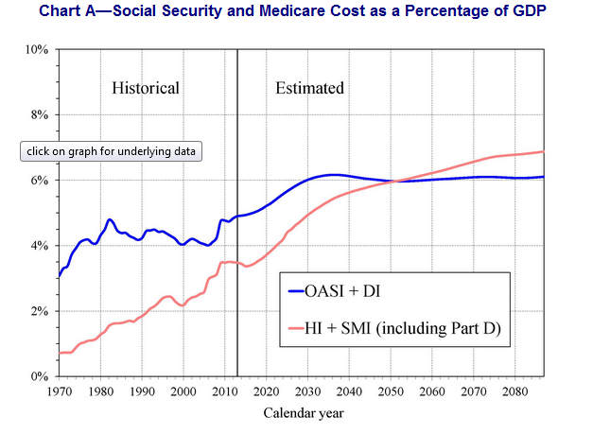
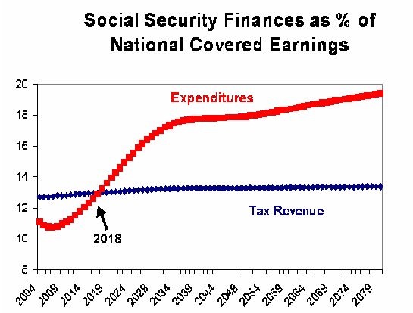

Slide 58
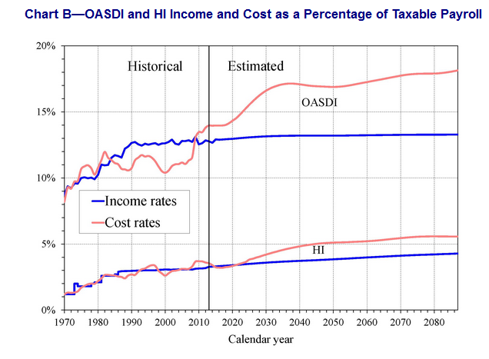
Social Security Retirement Age
1937 and before 65 yr
1938 65 yr 2 mth
1942 65 yr 10 mth
1943-54 66 yr
1955 66 yr 2 mth
1959 66 yr 10 mth
1960 and after 67 yr

Slide 59
History of Social Security Tax Rates
Year Tax Rate Ceiling Max. Contribution
1945 2.0 $3,000 $60
1970 9.6 (8.4) 7,800 $749
1984 14.0 (11.4) 37,800 $5,292
1998 15.3 (12.4) 68,400 $10,465
2001 15.3 (12.4) 80,400 $12,301
2007 15.3 (12.4) 97,500 $14,917
2017 15.3 (12.4) 127,200 $19,462

Slide 60
Social Security Example
= | = | = | = | = | = | = | = | = | =
SOCIAL SECURITY
= | = | = | = | = | = | = | = | = | =
Start up effect
 | 0 | 1 | 2 | 3 | 4 | 5 | 6 | 7 | 8
Young | 100 | 100 | 100 | 100 | 100 | 100 | 100 | 100 | 100
 | 0 | 0 | 0 | -10 | -10 | -10 | -10 | -10 | -10
Middle age | 100 | 100 | 100 | 100 | 100 | 100 | 100 | 100 | 100
 | 0 | 0 | 0 | -10 | -10 | -10 | -10 | -10 | -10
Old | 0 | 0 | 0 | 0 | 0 | 0 | 0 | 0 | 0
 | 0 | 0 | 0 | 20 | 20 | 20 | 20 | 20 | 20
Net effect |  |  | 0 | 20 | 10 | 0 | 0 | 0 | 0
= | = | = | = | = | = | = | = | = | =

Slide 61
Social Security Examples--Continued
Growing economy
 | 0 | 1 | 2 | 3 | 4 | 5 | 6 | 7 | 8
Young | 100 | 150 | 200 | 250 | 300 | 350 | 400 | 450 | 500
 | -10 | -15 | -20 | -25 | -30 | -35 | -40 | -45 | -50
Middle age | 100 | 150 | 200 | 250 | 300 | 350 | 400 | 450 | 500
 | -10 | -15 | -20 | -25 | -30 | -35 | -40 | -45 | -50
Old | 0 | 0 | 0 | 0 | 0 | 0 | 0 | 0 | 0
 | 20 | 30 | 40 | 50 | 60 | 70 | 80 | 90 | 100
Net effect |  |  | 15 | 15 | 15 | 15 | 15 | 15 | 15
= | = | = | = | = | = | = | = | = | =
Elimination impact
 | 0 | 1 | 2 | 3 | 4 | 5 | 6 | 7 | 8
Young | 100 | 100 | 100 | 100 | 100 | 100 | 100 | 100 | 100
 | 0 | 0 | 0 | -10 | -10 | -10 | 0 | 0 | 0
Middle age | 100 | 100 | 100 | 100 | 100 | 100 | 100 | 100 | 100
 | 0 | 0 | 0 | -10 | -10 | -10 | 0 | 0 | 0
Old | 0 | 0 | 0 | 0 | 0 | 0 | 0 | 0 | 0
 | 0 | 0 | 0 | 20 | 20 | 20 | 0 | 0 | 0
Net effect |  |  | 0 | 20 | 10 | 0 | -20 | -10 | 0
- | - | - | - | - | - | - | - | - | -

Slide 62
Introduction to Taxation
Taxes are one way of financing government along with borrowing, fees & charges, etc.
Basic criteria for evaluating taxation
  Efficiency
    Neutrality as a goal
    Do as little harm to the functioning of the private market
  Equity or fairness

Slide 63
Equity
Equity is basically a normative or ethical concept
Equity like beauty is in the eye of the beholder
Components of equity
  Horizontal equity—equal treatment of equals
  Vertical equity—the appropriate differential treatment of unequal

Slide 64
Taxes vs. Fees
Fees are related to prices for public services where exclusion is possible. Generally, the revenue generated by a fee is used to finance the activity.
Fees are applications of the benefits-received theory
In practice, the distinction is often not well defined.

Slide 65
Benefits-received vs. Ability-to-pay
Benefits-received
  Advantages
    Mirrors private market?
    Provides incentives for citizens
  Disadvantages
    Difficult to apply in some cases
    Not useful for redistribution
Ability-to-pay—advantages and disadvantages

Slide 66
Applications of the Equity Concept
Non tax examples
  Grading
  Criminal justice
Tax applications
  How are equals and non equals determined
    Benefits-received
    Ability-to-pay
  Examples
    Taxation of retirement income
    Taxation of unemployment compensation
    Taxation to finance education

Slide 67
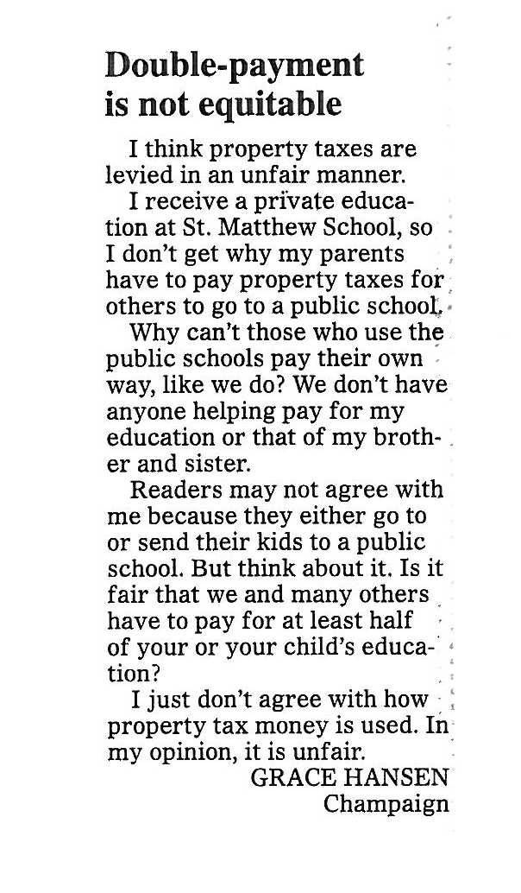
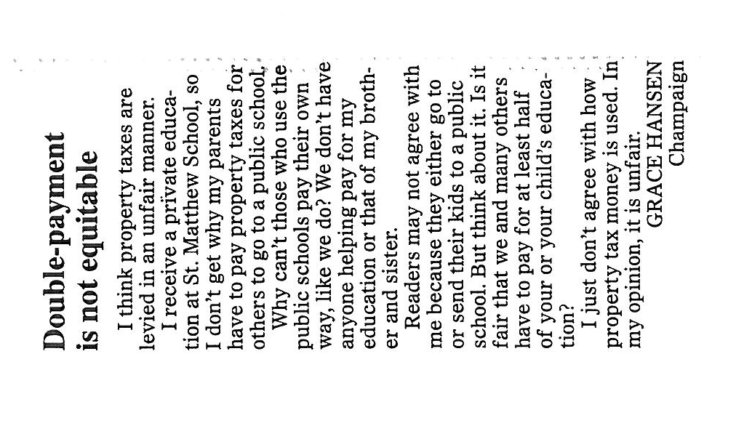
Letter to Editor
Champaign
News-Gazette
May 17, 2010

Slide 68
Basis for Taxation
Benefits-Received
Ability-to-Pay
  Income (flow)
  Consumption (flow)
  Wealth (stock)
  Stock vs. Flow measures
  Other factors that may impact ability-to-pay:
  Family size, unavoidable expenses, etc.

Slide 69
Basis for Taxation
Ability-to-pay (economic capacity)
Income
Consumption
Benefits-received
Base related to usage, e. g., motor fuels
Wealth
Property tax
Death and gift taxes
Sales and VA taxes
Broad-based consumption taxes

Slide 70
Tax Rates
Average rates
  Measure of overall burden
  ATR=Tax/Base
Marginal rates
  Measure of impact on behavior
  MTR= ΔTax/ ΔBase
  Actual base vs. income as base

Slide 71
Inclusive vs. Exclusive Rate
Ti=T/(B+T); Te=T/B; Ti = (Te)/(1+Te)
Ti=T/(T+B)=((1/B)/(1/B))*(T/(T+B))=(T/B)/(T/B+B/B)=Te/(Te+1)

Slide 72
Progressive, Proportional, Regressive
Arguments relating to progressivity
  Normative
    Minimum sacrifice
    Equal sacrifice
    Proportional sacrifice
    Exemption of basic necessities
  Efficiency (later)\
Definition
  Regressive: ATR decreases as base increases
  Proportional: ATR constant as base increases
  Progressive: ATR increases as base increases

Slide 73
Rationales for Progressivity
Example
What are the problems with this approach?
  Is utility measurable?
  Does MU decline?
  Can you compare utility among persons?

Slide 74
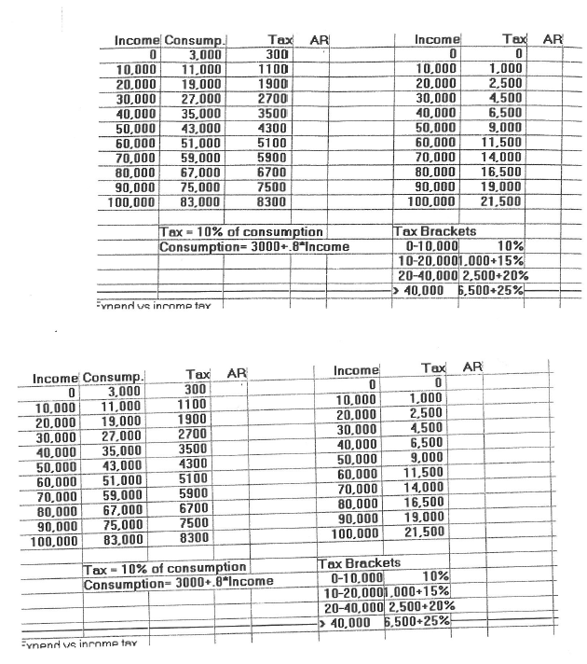

Slide 75
Measuring Progressivity

Slide 76
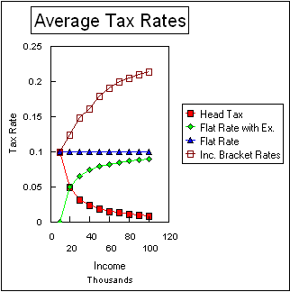

Slide 77
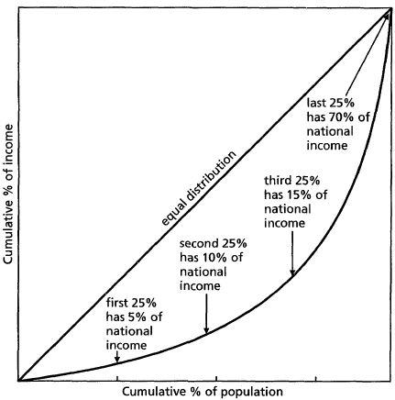
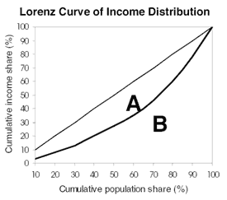
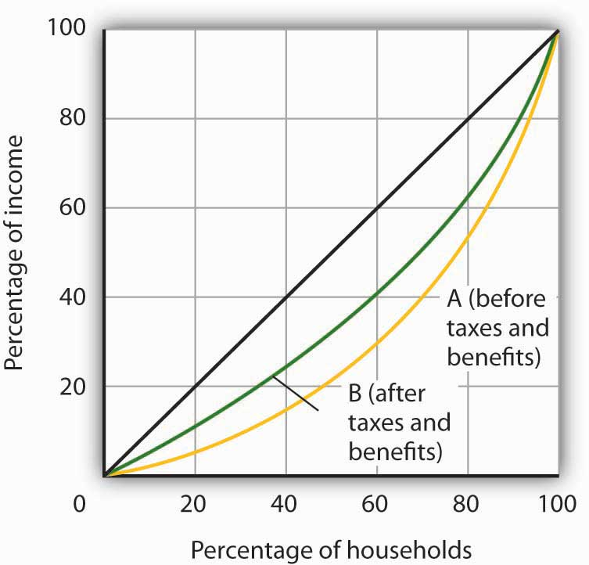
Gini Coefficient = A/(A+B)
G=0; Complete Equality
G=1; Complete Inequality

Slide 78
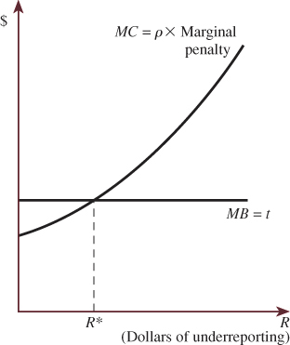
Tax Avoidance, Evasion and Deliquency
Economics of crime
  Benefits
  Costs
    Direct costs
    Probability of arrest and conviction
    Severity of punishment
Economics of evasion
  Benefits—taxes saved
  Costs
    Direct costs
    Psychic costs
    Probability of detection
    Severity of punishment

Slide 79
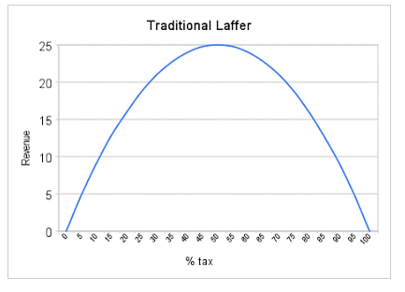
Tax Rates and Tax Revenues
Visualizing the Laffer Curve
Laffer Curve—Tax rates and Tax Revenues
Are tax revenues proportional to tax rates?
The example of a tariff?
Elasticity issues
  Cigarettes?
  A tax on Cokes vs. a tax on soft drinks?
The Laffer curve
“Dynamic scoring”
  Short run
  Long run
  Adjustments—example of income tax

Slide 80
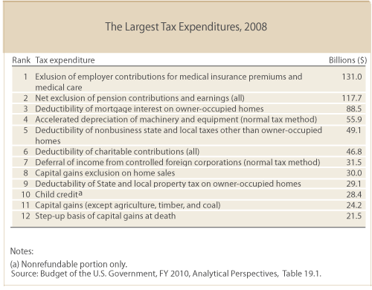
Tax Expenditures
Tax expenditures are revenue losses attributable to tax provisions that often result from the use of the tax system to promote social goals without incurring direct expenditures. How tax expenditures are structured affects both who will benefit from them and how much they will reduce federal revenues.

Slide 81
Partial equilibrium approach
The excise tax example
  Selective excise
  Specific (unit) vs. ad valorem
Is the tax applied on the consumer or the producer?
  Different approaches
  Same results

Slide 82
Excise tax incidence--examples
Basic example—sharing the price burden
  Consumer and producer price burden
  Equivalence of consumer and producer imposition
  Short run and long run
Special cases
  Inelastic supply
  Inelastic demand
  Elastic supply

Slide 83
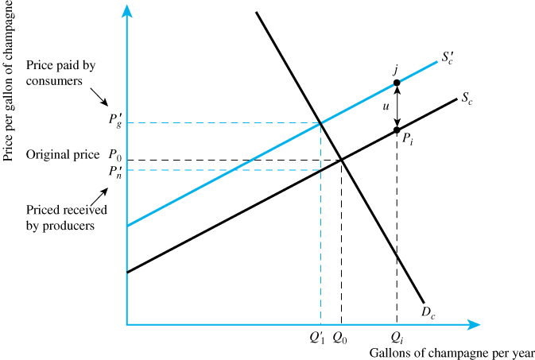
Tax Legal Responsibility of Seller

Slide 84
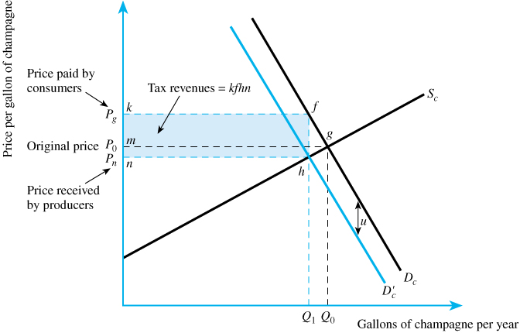
Tax Legal Responsibility of Buyer

Slide 85
Taxation and efficiency
Review of efficiency concept
Welfare cost and excess burden
The excise example once again—Basic case
  Tax revenues
  Welfare cost s
Special cases
  Inelastic supply
  Inelastic demand

Slide 86
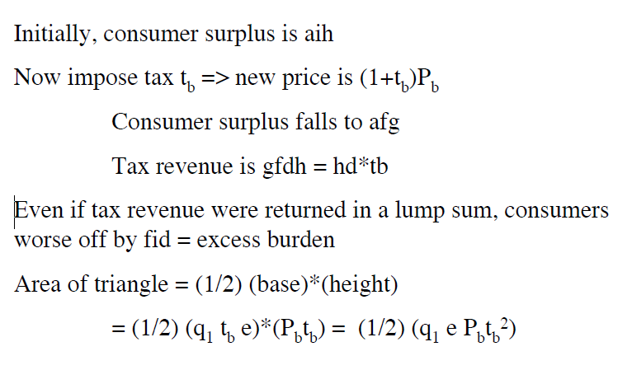
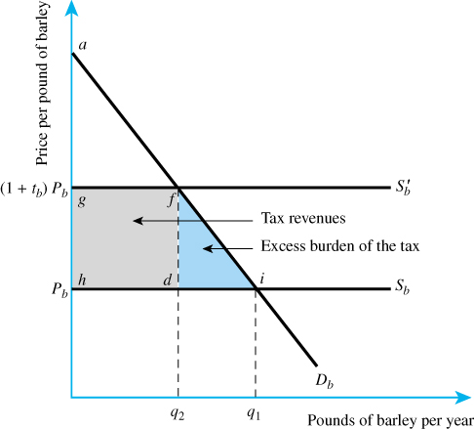

Slide 87
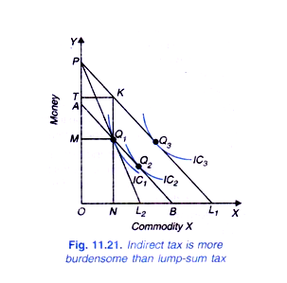
Lump Sum vs. Selective Excise Taxation

Slide 88
Tax rates and tax revenues
Are tax revenues proportional to tax rates?
The example of a tariff?
Elasticity issues
  Cigarettes?
  A tax on Cokes vs. a tax on soft drinks?
The Laffer curve
“Dynamic scoring”
  Short run
  Long run
  Adjustments—example of income tax

Slide 89
Individual Income Taxation
Definition of income
  Measure of ability-to-pay
  Haig-Simons, Accretion concept, Comprehensive Income, Economic income
  “Income may be defined as the algebraic sum of the market value of rights exercised in consumption plus the change in value of the store of property rights between the beginning and end of the period in question.” Simons
  Income = Consumption + Change in Wealth

Slide 90
Calculation of Income
I C NW₀ NW₁
100 100 50 50
110 100 40 50
90 100 60 50

Slide 91
Individual Income Taxation (continued)
Other definitions
  Legal (AGI)
  Income as production
Income vs. consumption (a first look)
  Income = Consumption + Saving
  Income – Consumption = Saving
  The issue is the tax treatment of savings

Slide 92
Applications of the Haig-Simons Definition
Wages H-S income | The corporate income (Disc. Later)
Retained earnings (Discussed later) | Employee-paid safety equipment Excludable H-S income
Social Security payments H-S income | Death transfers H-S income
Gifts H-S income | Employer-paid education (Depends on purpose)
Unemployment Compensation H-S income | Housing—owning vs. renting Net imputed rent H-S income
Bequests H-S income to heirs | Employer-paid vacation H-S income
Interest H-S income (real return only) | Owning vs. leasing a car
Employer-paid insurance H-S income | Travel expenses for sales person Excludable H-S income
Dividends H-S income (real return only) | Inflationary wage increases H-S income (with indexation)
Capital gains H-S income (real return only) | Employer-paid pension contributions H-S income (real return only)
Education expenses—not employer paid (Depends on purpose) | Child care ????
Business class air travel for business purposes (Depends on purpose) | Free checking accounts (tax Interest, charge for checking)

Slide 93
The U. S. Income Tax
Step by step
Comprehensive Income (Haig-Simons)
  Exclusions
AGI
  Exemptions and deductions
Taxable Income
  Tax rates, filing status
Tax Liability (before and after credits)
  Withholding, estimated payments
Final payment
1040 and Schedule A—Explained line by line http://datatools.taxpolicycenter.org/1040/index.html

Slide 94


Slide 95
Rationale for Exemptions and Deductions
Credits, Deductions and Exemptions
Exemptions (ability-to-pay)
Deductions
  Minimum standard
  Itemized
    Ability-to-pay
      Health care costs
      State and local taxes?
      Casualty losses
    Incentives
      Charitable contributions
      Mortgage interest
      State and local taxes?

Slide 96


Slide 97


Slide 98
History of Income Taxation
Constitutional constraints—direct taxes apportioned among the states on basis of population
  Property taxes
  Income taxes
Early revenue—tariffs, sale of land, and some excises
Civil war income tax

Slide 99
History of Income Taxation
1894 income tax unconstitutional
State income taxes in early 20th century
16th amendment—1913
First modern income tax—1913
Wars and the depression
High nominal marginal rates and narrow base
1980s onward

Slide 100


Slide 101


Slide 102


Slide 103


Slide 104
Individual Income Tax Topics
Inflation
  Bracket creep
  Taxation of income from capital
Tax treatment of family—equity on various fronts
  Reasons for joint filing
  Marriage penalty and rewards
Income averaging
Housing (r-m-d)

Slide 105
Inflation-Hypothetical Situations
Income | Tax
0-20,000 | 10 %
20,000-40,000 | 2,000 + 20% of excess
40,000 and up | 6,000 + 25% of excess
Year | Income | Tax | ATR
2000 | 20,000
2000 | 40,000
Year | Income | Tax | ATR | Price Index
1990 | 20,000 |  |  | 100
2000 | 40,000 |  |  | 200
Bracket creep

Slide 106
Inflation-Hypothetical Situations
Income | Tax
0-20,000 | 10 %
20,000-40,000 | 2,000 + 20% of excess
40,000 and up | 6,000 + 25% of excess
Indexation
Income | Tax
0-40,000 | 10 %
40,000-80,000 | 4,000 + 20% of excess
80,000 and up | 12,000 + 25% of excess
Year | Income | Tax | ATR | Price Index
1990 | 20,000 |  |  | 100
2000 | 40,000 |  |  | 200

Slide 107
Inflation and income from capital
Income for capital
Nominal and real returns
I_{nom} = I_{real} + ¶
  Capital gains
    Deferral
    Special rates
    Taxation of inflationary gains
  Dividends
  Dividends vs. salary
  S & L interest

Slide 108
Inflation and taxation of income from capital
Brackets indexed for inflation
Exemptions and minimum deduction indexed for inflation
Return on capital: Nominal rate = real rate + expected inflation
Nominal return taxed—Haig-Simons would only tax real return because this is the portion that represents ability to consume without reducing assets
Capital Gains
  Taxed when realized, not when accrued
  Reduces present value of tax cost
  Haig-Simons would tax when accrued
  Inflationary gain as well as real gain taxed
  Haig-Simons would tax only real gain by allowing basis to be adjusted for inflation
  Special rates for long-term capital gains
  Step of in basis for capital gains at death (capital gains not taxed at death and heirs not subject to tax)

Slide 109
Current Capital Gains (and Dividends) Rate
Tax Bracket | Capital Gain Tax Rate
 | Short Term | Long Term
10% | 10%
15% | 15%
25% | 25% | 20% Max
28% | 28%
33% | 33%
35% | 35%
39.6% | 39.6%

Slide 110
Tax treatment of family
Income | Tax
0-20,000 | 10 %
20,000-40,000 | 2,000 + 20% of excess
40,000 and up | 6,000 + 25% of excess
Family A | Income | Tax | ATR
Spouse 1 | 40,000
Spouse 2 | 0
Total | 40,000
Family B | Income | Tax | ATR
Spouse 1 | 20,000
Spouse 2 | 20,000
Total | 40,000

Slide 111
Income Splitting
Income | Tax
0-40,000 | 10 %
40,000-80,000 | 4,000 + 20% of excess
80,000 and up | 12,000 + 25% of excess
Family A | Income | Tax | ATR
Spouse 1 | 40,000
Spouse 2 | 0
Total | 40,000

Slide 112
Individual Income Tax Topics
(continued)
Death and gift taxes and income tax
Taxation of housing—owning vs. renting
  R-m-d
Household work (child care, housekeeping, repair, etc.)
AMT

Slide 113
Housing—Owning vs. Renting
Renter
  Rent
  Less maintenance less depreciation less property tax less mortgage interest
Owner occupant
  No imputed rent but property tax and mortgage interest deductable
Difference—(R-M-Dep)
  Itemization vs. non-itemization adds to complexity

Slide 114
An Example for 1947
Ross Lockridge, Jr. and Raintree County
Spreading income– no averaging and high marginal rates
Discussion about prize—negotiated for a 5-year payout
His manuscript had won a $150,000 novel prize from MGM studios that included the studio's right to make a film from the novel.
Splitting income between couples–no joint returns
$25,000 Payment to wife–could it be justified
1948 first year of joint filing, income splitting and common property states
Contribution to foundation for father.
Edmund Wilson, Cold War and the Income Tax: A Protest
Joe Louis

Slide 116
Tax comparison: AMT versus regular taxes
AMT computation | Regular tax computation
Adjusted gross income Plus: AMT adjustments and preferences Less: AMT itemized deductions | Adjusted gross income Less: personal and dependency exemptions Less: greater of total itemized deductions, or standard deduction
Actual AMT | Total tax
Lost Exemptions.
State and local taxes.
Interest on second mortgages. If you borrowed against your home for some purpose other than expenses related to the home, the interest deduction won't be allowed under AMT.
Tax-exempt interest. Interest otherwise exempt from the regular income tax might not be for the AMT.
Tax shelters. The AMT provides reduced tax benefits for investments in certain types of partnership or limited liability company arrangements involving activities such as drilling for gas or oil.
Tax-exempt interest. Interest otherwise exempt from the regular income tax might not be for the AMT.
Exemptions:
$45,000 for married couples filing jointly with phase-out beginning when AMT income is over $150,000.
$33,750 for single people, or heads of households, with phase-out beginning when AMT income is over $112,500.
$22,500 for married couples filing separately with phase-out beginning when AMT income is over $75,000.
Rates:
26% on the first $175,000 ($87,500 for married couples filing separately) and 28% on the excess. Again, the AMT brackets are not adjusted for inflation, which causes much greater exposure to the tax as the years go by. If the AMT exceeds your regular tax, you have to pay the greater amount.

Slide 117

CBO's Projected Effects of the Individual Alternative Minimum Tax
Source: Congressional Budget Office.
Note: The alternative minimum tax requires some taxpayers to calculate their taxes under a more limited
set of exemptions, deductions, and credits than the set applicable under the regular individual income tax.
Some taxpayers are affected by the AMT but do not have AMT liability because the AMT limits their credits
taken under the regular tax.

Slide 118
Impacts on Work
Theoretical possibilities
  Income and substitution effects
Notable examples
Primary worker
Secondary worker
Impacts on Savings

Slide 119



Slide 120


Slide 121



Eduardo Saverin

Slide 122
Taxman
George Harrison
Let me tell you how it will be,
There's one for you, nineteen for me,
Cause I'm the taxman,, yeah, I'm the taxman
Should five percent appear too small,
Be thankful I don't take it all,
'Cause I'm the taxman, yeah, I'm the taxman
If you drive a car, I'll tax the street,
If you try to sit, I'll tax your seat
If you get too cold, I'll tax the heat,
If you take a walk, I'll tax your feet, taxman,
'Cause I'm the taxman, yeah, I'm the taxman
Don't ask me what I want it for,
(ha ha Mr. Wilson)
If you don't want to pay some more,
(ha ha Mr. Heath)
'Cause I'm the taxman, yeah, I'm the taxman
Now my advice for those who die,
Declare the pennies on your eyes,
'Cause I'm the taxman, yeah, I'm the taxman
And you're working for no one but me.

Slide 123
Billy Joel and the Notch Problem
Billy Joel, Movin' out (Anthony's song)
...
You ought-a know by now
You can pay Uncle Sam with the overtime
Is that all you get for your money?
And if that's what you have in mind
Then that's what you're all about
Good luck movin up cause I'm movin out

Slide 124


Slide 125


Slide 126
Domenici-Rivlin-Debt Reduction Task Force 2010

Slide 127
State Income Taxation
General issues
  Taxation and Mobility
  Interaction with federal tax
Illinois
  Definition—begins with AGI with modifications
    Include all capital gains and S & L interest
    Excludes retirement income
  $2,000 exemption
  3 to 5 percent flat rate
  Property tax credit (5 percent)
  Illinois EITC (5 percent of federal, refundable)

Slide 128
Introduction to the Corporate Income Tax (and Related Issues of Business Taxation)
What is a corporation?
  Legal vs. economic
Rationale for tax corporations
  Avoiding taxing individuals??
  Two Views
    Absolutist--benefits-based tax reflecting advantage of corporate form
    Integrationist—dealing with shortcomings of the individual income tax
  Which rationale applies to U. S.?
    Treatment of dividends and retrained earnings

Slide 129
Corporate Taxation--Basics
Tax base: Net income = Revenue- Costs
Economic profit vs. accounting profit
Tax rates—progressivity?
Interest deductible, but dividends not-- Debt vs. equity
Dividends vs. retained earnings—double taxation issues (Efficiency issues)
Depreciation and expensing issues
Investment tax credits?? (partial offset of purchase cost) (ended in 1986)
Multi-jurisdiction issues—Worldwide vs. territorial

Slide 130
Depreciation
Discount rate = 10%
MTR = 34%

Slide 131
The Incidence of the Corporate Tax
Is corporate profit economic profit?
Two approaches
  Excise approach
    Burden distributed as if a excise tax on corporate sales
    Regressive
  General equilibrium approach (Harberger)
    Impact lowers rate of return on all (not just corporate capital
    Progressive

Slide 132

General Equilibrium Approach
(Simplified)

Slide 133

Excess Burden Analysis

Slide 134
General Equilibrium Results
Tax is borne by the owners of all capital
Tax is progressive
Tax creates excess burden
Tax reduces corporate investment and may reduce overall investment
  User cost of capital increases
Tax may reduce slightly rate of economic growth

Slide 135

Corporate Issues:
The Decline of Corporate Taxes
https://www.forbes.com/sites/modeledbehavior/2016/05/08/the-decline-of-corporations/#13f608ca4431

Slide 136
Reasons
Decline of profits as percent of national income
Alternatives to corporate structure
“Tax Planning”
  Domestic
  International
    Income and cost shifting
    Transfer pricing

Slide 137
Tax Planning
High to low rates
Between jurisdictions
Between taxpaying entities
  People
  Other entities
Between different types of income
Between time periods

Slide 138
International Issues
Tax Planning
  Transfer pricing
  Earnings Stripping—borrowing as substitute for repatriation (interest deductions, etc.
  Check the box
  Cross crediting
Territorial vs. worldwide taxation
  Foreign credit
  Repatriation
Inversions, etc
  Losing economic activity vs. losing tax revenue

Slide 139


Slide 140
Introduction to Consumption Taxation
Philosophical issues
  Should tax be based on what is produced or what is used up?
Impact on growth
  Income –Consumption = Savings
  Would the exclusion of savings increase growth
Listen and watch for next week: Pro-growth and progressive tax reform: A closer look at the X tax http://www.aei.org/events/2012/06/04/pro-growth-and-progressive-tax-reform-a-closer-look-at-the-x-tax/

Slide 141
Consumption Taxes
Comprehensive
  Expenditure or cash-flow taxes
  “Flat Tax”
  X-Tax
Transaction-based
  General sales taxes
    FAIR tax
  VAT
  Excise taxation

Slide 142
Inclusive vs. Exclusive Rate
Review--Again
Ti = (Te)/(1+Te)

Slide 143
Expenditure taxes
Cash-Flow Tax
Comprehensive base
Progressive rates possible
Exemptions and deductions possible
Resembles a modified income tax
Income tax could be converted to an expenditure tax with unlimited tax deferral vehicles such as IRA, 401K, etc.

Slide 144
The General Equivalency of
Traditional vs. Roth
(an aside)
Other Issues:
Differing tax rates
Differing withdrawal rules

Slide 145
Flat Tax (Hall-Rabushka)
Flat rate, but also consumption based
  A flat income tax vs. flat consumption tax
Integrated individual and business taxation
  Individual component
    Flat tax on wages Large exemption possible and expected
    Deductions possible, but not desirable
    No tax on capital income
  Business component
    Flat tax on sales less purchases from other firms less wages paid
    Expensing
    No deductibility of interest
Much like a VAT except with finer targeting of ability-to-pay
Bradford X-Tax variation—graduated rates

Slide 146
Flat Tax (Hall-Rabushka)
X Tax Variation (Bradford)
Flat rate, but also consumption based
  A flat income tax vs. flat consumption tax
Integrated individual and business taxation
  Individual component
    Flat tax on wages and pensions
    Large exemption possible and expected
    Deductions possible, but not desirable
    No tax on capital income
  Business component
    All business entities taxed—not just corporations
    Flat tax on sales less purchases from other firms less wages paid and pension contributions
    Expensing
    No deductibility of interest paid or taxation of interest received
    No deductibility of non-pension fringe benefits or S-L taxes
    (Relation to destination-based cash-flow tax with border tax adjustment)
Much like a VAT except with finer targeting of ability-to-pay (collects part at business level and part at individual level)
Bradford X-Tax variation—graduated rates

Slide 147

Postcard Return--Individual

Slide 148

Postcard Return--Business

Slide 149
Consumption vs. Income Tax Issues
Philosophical
  Tax on contribution to output (income)
  Tax on use of output (consumption)
Taxation of savings is the issue
  Consumption and income is highly correlated
  Annual vs. lifetime
Progressivity?
Transition issues

Slide 150
General Sales Tax
Transactions-based
Fine-tuning difficult
The conceptual base
  Retail sales including services
    Exclusion of business purchases
    Housing, education and medical care?
  Government production
The actual base
  Many services excluded (equity and other reasons)
  Many business purchases taxed
    Cascading issues
    Encouragement for vertical integration, non-outsourcing
  Exemptions and exclusions
    Food and drugs
    Charitable purchases

Slide 151
General Sales Tax
(continues)
History—states and localities
Incidence
  Impact of exclusions
  Annual vs. lifetime
Current issues
  Destination or origin based? (Sales outside of jurisdiction)
  Internet and other remote sales
  Horizontal equity issues (“Bricks and mortar vs. remote vendors)
  The use tax
    Avoidance and evasion
  Nexus
  Streamlined sales tax
  “Tax the Internet” What does it mean?
    Connectivity
    Content
    Transactions

Slide 152
Value Added Taxes
Multistage transaction-based tax
Example
Stage | Selling Price | Value Added
Farmer-Wheat | 20 | 20
Mill-Flour | 50 | 30
Baker-Bread | 80 | 30
Grocery-Retail | 100 | 20
Final selling price | 100
Sum of VA |  | 100

Slide 153
Value Added Taxes
(continued)
General equivalence of VAT and a general sales tax (and flat tax)
Administrative issues
  Consumption type (investments subtracted)
  Methods
    Subtraction
    Credit-invoice method
    Addition
  Uniform or different rates
  Exports
Political Issues
  Regressivity?
  “Money machine”

Slide 154
Selective Excise and Sales Taxes
Reasons
  Revenue
  Sumptuary taxes
  Externality adjustment
  Implementation of benefit-received approach
Incidence and excess burden
  Previously discussed
  Depends on consumption patterns

Slide 155
Taxation of Wealth
Stocks and flows
Wealth taxes
  Comprehensive wealth tax
    Capital in the Twenty-First Century by Thomas Piketty
  Death and gift taxes
  Property taxes
Classification of property
  Real
  Personal
    Tangible
    Intangible

Slide 156
Death and Gift Taxes
Death taxes
  Estate taxes
  Inheritances taxes
Gift taxes
Why do they go together?
The interrelationship of individual income taxation and death and gift taxes
  Haig-Simons analysis
  Second best
  Dealing with the base of appreciated property

Slide 157
Death and Gift Taxes Continued
Rationale
  “No right to bequeath”
  Vertical equity
  Intergenerational transfers may lessen incentive to work
  Choice between consuming or bequeathing
  Implications for accumulation

Slide 158

Estate and Gift Tax Rates

Slide 159
Estate and Gift Taxation
Why integration?
Interrelationship of the estate and gift tax base
Base
  Taxable gifts plus
    $14,000 per person per year exemption (2014)
  Assets at death
  Less debts and expenses less charitable bequests less spousal bequest
  $5,340,000 (2014)
Effective tax rates
Importance of tax planning
  “A voluntary tax”

Slide 160
Two examples
Use of yearly gifts
Use of spousal exemption (prior to 2013)
  Is it always wise to use full amount
  A and B trusts

Slide 161

Tax Gap

Slide 163

Bowles-Simpson
Commission-2010

Slide 164
Domenici-Rivlin-Debt Reduction Task Force 2010

