Slide 1
ECON 411 Public Sector Economics PowerPoint Material 2020
J. Fred Giertz
Institute of Government and Public Affairs and Department of Economics
University of Illinois at Urbana
Online Lecture 9 —April 8, 2020

Slide 2
Taxation--Plan
Introduction to basic definitions and concepts
Taxes defined
Equity and efficiency in taxation
Basis for allocating tax burden
Tax rates
Measuring tax burdens
Economic impact of taxes
The analysis of important taxes
Income taxes
Business taxes
Consumption taxes
Wealth taxes

Slide 3
Introduction to Taxation
Taxes are one way of financing government along with borrowing, fees & charges, etc.
Basic criteria for evaluating taxation
Efficiency
Neutrality as a goal
Do as little harm to the functioning of the private market
Equity or fairness

Slide 4
Taxes vs. Fees
Fees are related to prices for public services where exclusion is possible. Generally, the revenue generated by a fee is used to finance the activity.
Fees are applications of the benefits-received theory
In practice, the distinction is often not well defined.

Slide 5
Equity
Equity is basically a normative or ethical concept
Equity like beauty is in the eye of the beholder
Components of equity
Horizontal equity—equal treatment of equals
Vertical equity—the appropriate differential treatment of unequal

Slide 6
Applications of the Equity Concept
Non tax examples
Grading
Criminal justice
Tax applications
How are equals and non equals determined
Benefits-received
Ability-to-pay
Examples
Taxation of retirement income
Taxation of unemployment compensation
Taxation to finance education

Slide 7
Basis for Apportioning Taxes Benefits-received vs. Ability-to-pay
Benefits-received approach
Rationale—similar to private sector
Advantages
Mirrors private market?
Provides incentives for citizens
Disadvantages
Difficult to apply in some cases
Not useful for redistribution

Slide 8
Basis for Taxation (2)
Ability-to-pay (Economic capacity) avantages and disadvantages
Rationale
Ways of measuring ability-to-pay
Income (flow)
Consumption (flow)
Wealth (stock)
Stock vs. Flow measures
Other factors that may impact ability-to-pay:
Family size, unavoidable expenses, etc.

Slide 9
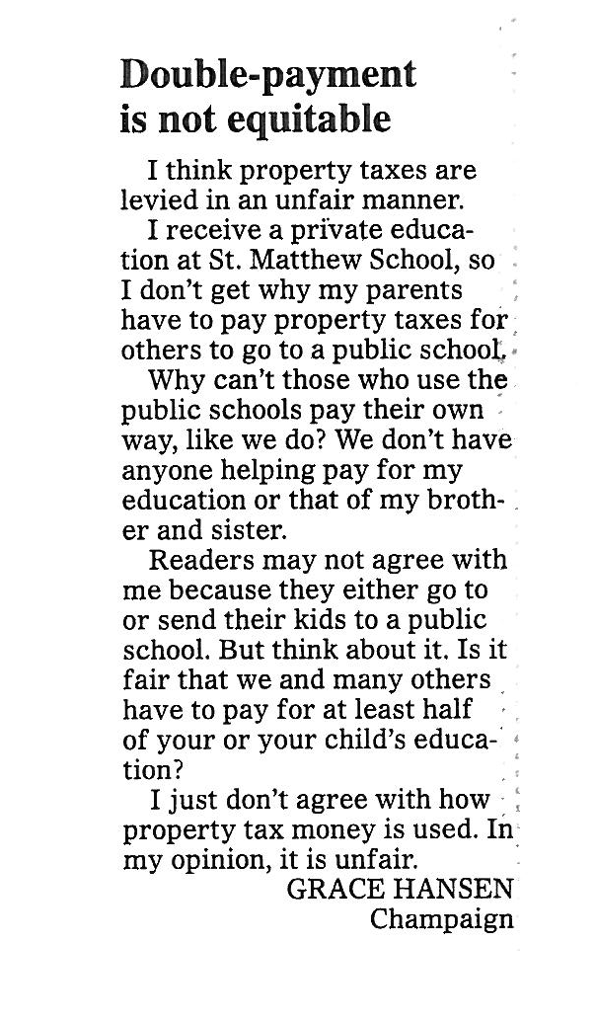
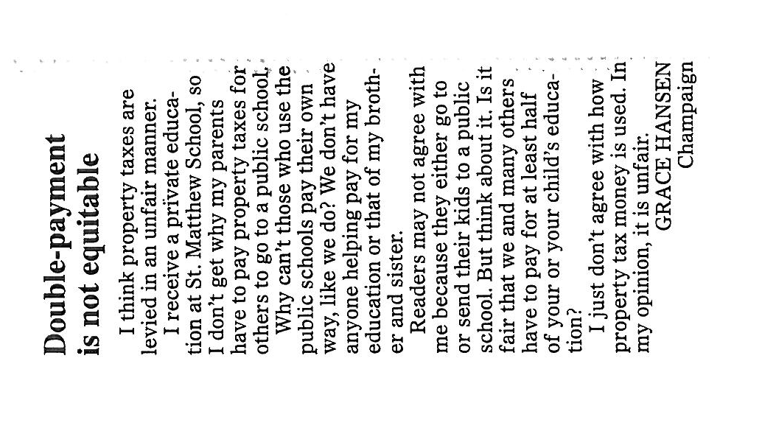
Letter to Editor Champaign News-Gazette May 17, 2010

Slide 10
Basis for Taxation
Ability-to-pay (economic capacity)
Income
Consumption
Benefits-received
Base related to usage, e. g., motor fuels
Wealth
Property tax
Death and gift taxes
Sales and VA taxes
Broad-based consumption taxes

