Slide 1
ECON 411 Public Sector Economics PowerPoint Material 2020
J. Fred Giertz
Institute of Government and Public Affairs and Department of Economics
University of Illinois at Urbana
Online Lecture 8 —April 7, 2020

Slide 2
Overview of How Social Security Works
Most workers must participate in the program
The program is mainly funded by a “contribution” shared by workers and employees
The contribution (really a tax) a flat percentage up to a maximum levels
Benefits depend on past earnings, family status, age when benefits are claimed, etc .
Lower income recipients receive a higher percentage of their lifetime earnings than those with higher incomes (a higher replacement rate)

Slide 3
History of Social Security Tax Rates
Year Tax Rate Ceiling Max. Contribution
1945 2.0 $3,000 $60
1970 9.6 (8.4) 7,800 $749
1984 14.0 (11.4) 37,800 $5,292
1998 15.3 (12.4) 68,400 $10,465
2001 15.3 (12.4) 80,400 $12,301
2007 15.3 (12.4) 97,500 $14,917
2017 15.3 (12.4) 127,200 $19,462
Social Security Retirement Age
1937 and before 65 yr
1938 65 yr 2 mth
1942 65 yr 10 mth
1943-54 66 yr
1955 66 yr 2 mth
1959 66 yr 10 mth
1960 and after 67 yr
Distributional effects
When retired
Income
Sex
Marital status

Slide 4
Social Security Funding Issues

Slide 5
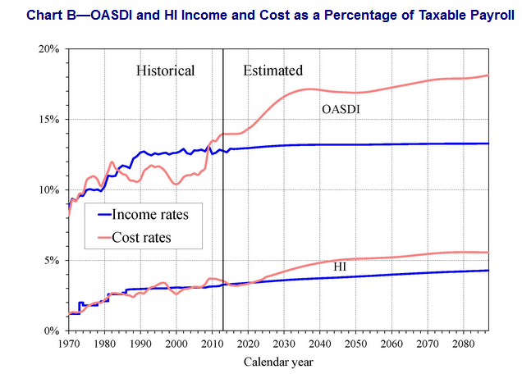
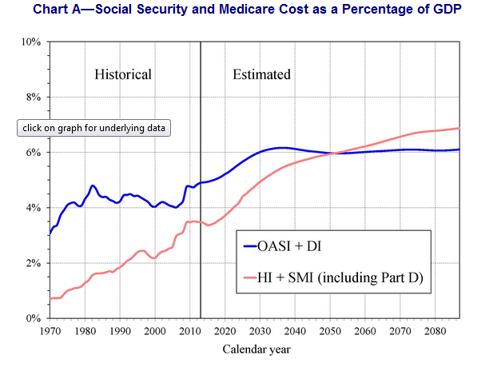

Slide 6
The Past and Future of Social Security Funding
Is it a "good deal?“
It depends on when the person retires
Good for those in past, less so for those in future
What determines is SS is good deal?
Start up effect
Demographics
Longevity
Differing age cohort sizes
Immigration
Tax rates
Workforce participation
Economic growth rates

Slide 7
Social Security—Start up impact
= | = | = | = | = | = | = | = | = | =
SOCIAL SECURITY
= | = | = | = | = | = | = | = | = | =
Start up effect
 | 0 | 1 | 2 | 3 | 4 | 5 | 6 | 7 | 8
Young | 100 | 100 | 100 | 100 | 100 | 100 | 100 | 100 | 100
 | 0 | 0 | 0 | -10 | -10 | -10 | -10 | -10 | -10
Middle age | 100 | 100 | 100 | 100 | 100 | 100 | 100 | 100 | 100
 | 0 | 0 | 0 | -10 | -10 | -10 | -10 | -10 | -10
Old | 0 | 0 | 0 | 0 | 0 | 0 | 0 | 0 | 0
 | 0 | 0 | 0 | 20 | 20 | 20 | 20 | 20 | 20
Net effect |  |  | 0 | 20 | 10 | 0 | 0 | 0 | 0
= | = | = | = | = | = | = | = | = | =

Slide 8
Social Security Examples--Continued
Growing economy
 | 0 | 1 | 2 | 3 | 4 | 5 | 6 | 7 | 8
Young | 100 | 150 | 200 | 250 | 300 | 350 | 400 | 450 | 500
 | -10 | -15 | -20 | -25 | -30 | -35 | -40 | -45 | -50
Middle age | 100 | 150 | 200 | 250 | 300 | 350 | 400 | 450 | 500
 | -10 | -15 | -20 | -25 | -30 | -35 | -40 | -45 | -50
Old | 0 | 0 | 0 | 0 | 0 | 0 | 0 | 0 | 0
 | 20 | 30 | 40 | 50 | 60 | 70 | 80 | 90 | 100
Net effect |  |  | 15 | 15 | 15 | 15 | 15 | 15 | 15
= | = | = | = | = | = | = | = | = | =
Elimination impact
 | 0 | 1 | 2 | 3 | 4 | 5 | 6 | 7 | 8
Young | 100 | 100 | 100 | 100 | 100 | 100 | 100 | 100 | 100
 | 0 | 0 | 0 | -10 | -10 | -10 | 0 | 0 | 0
Middle age | 100 | 100 | 100 | 100 | 100 | 100 | 100 | 100 | 100
 | 0 | 0 | 0 | -10 | -10 | -10 | 0 | 0 | 0
Old | 0 | 0 | 0 | 0 | 0 | 0 | 0 | 0 | 0
 | 0 | 0 | 0 | 20 | 20 | 20 | 0 | 0 | 0
Net effect |  |  | 0 | 20 | 10 | 0 | -20 | -10 | 0
- | - | - | - | - | - | - | - | - | -

Slide 9
The Past and Future of Social Security Funding
Is it a "good deal?“
It depends on when the person retires
Good for those in past, less so for those in future
What determines is SS is good deal?
Start up effect
Demographics
Longevity
Differing age cohort sized
Immigration
Tax rates
Workforce participation
Economic growth rates

Slide 10
Problems and Options in 21st Century--Today
The options are simple, but stark and politically problematic
More revenues
Lower benefits
Revenue enhancements
Higher tax rates
General fund financing
Eliminate the cap
Lower benefits
Inflation adjustment changes
Inflation not productivity
Higher retirement age
Lower replacement rate for high income recipients

Slide 11
Other Issues
Privatization—Option
Move to DC plans
DC hybrid with SS
Prefunded pooled investments
Economic Impacts of Social Security
Distributional—old vs. young
Work effort
Savings
What explains social security’s popularity?
“The third rail of politics”
Insurance motive
Median voter and fixed costs

