Slide 1

ECON 411
Public Sector Economics
PowerPoint Material
2020
J. Fred Giertz
Institute of Government and Public Affairs and Department of Economics
University of Illinois at Urbana
Online Lecture 7 —April 7, 2020

Slide 2
Social Security and Retirement Issues
Preparation for retirement-the “three-legged stool
  Pensions
  Private savings
  Social security (government program)
Pensions-two basic types
  Defined benefit (DB)
    Guaranteed benefits based upon years of service, salary, etc.
    Risk borne by pension sponsor
  Defined contribution (DC)
    Benefits based on participants’ savings and investment returns
    Risk borne by participants
Funding options
  Prefunded (All DC and some DB plans)
  Pay-as-you-go (Some DB and Social security)

Slide 3
Social Security
Social security in the U. S. is a compulsory retirement program for most workers
Governmental DB plan
Pay-as-you-go financing
Intergenerational transfer--transfer from current workers to retirees, etc.
Compare to private retirement
Social security and Medicaid

Slide 4
Overview of How Social Security Works
Most workers must participate in the program
The program is mainly funded by a “contribution” shared by workers and employees
The contribution (really a tax) a flat percentage up to a maximum levels
Benefits depend on past earnings, family status, age when benefits are claimed, etc .
Lower income recipients receive a higher percentage of their lifetime earnings than those with higher incomes (a higher replacement rate)

Slide 5
History of Social Security Tax Rates
Year Tax Rate Ceiling Max. Contribution
1945 2.0 $3,000 $60
1970 9.6 (8.4) 7,800 $749
1984 14.0 (11.4) 37,800 $5,292
1998 15.3 (12.4) 68,400 $10,465
2001 15.3 (12.4) 80,400 $12,301
2007 15.3 (12.4) 97,500 $14,917
2017 15.3 (12.4) 127,200 $19,462
Social Security Retirement Age
1937 and before 65 yr
1938 65 yr 2 mth
1942 65 yr 10 mth
1943-54 66 yr
1955 66 yr 2 mth
1959 66 yr 10 mth
1960 and after 67 yr
Distributional effects
When retired
Income
Sex
Marital status

Slide 6
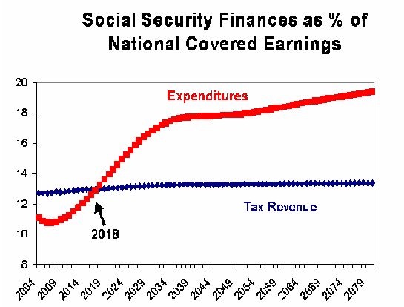
Social Security Funding Issues

Slide 7
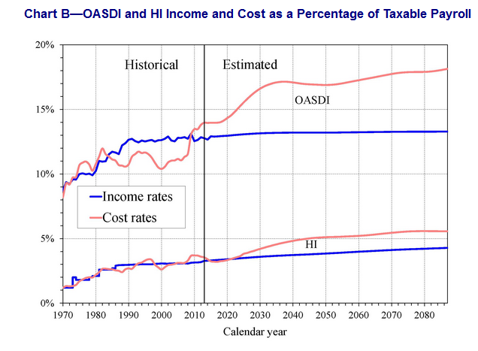
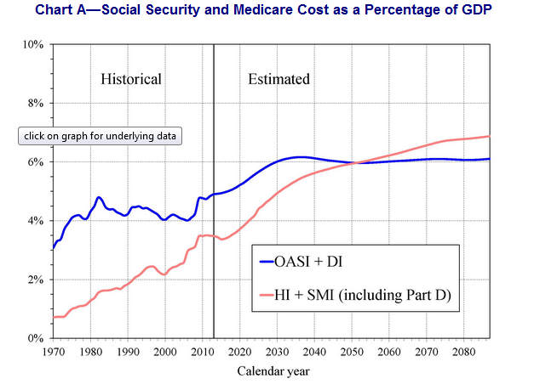

Slide 8
The Past and Future of Social Security Funding
Is it a "good deal?“
  It depends on when the person retires
  Good for those in past, less so for those in future
What determines is SS is good deal?
  Start up effect
  Demographics
    Longevity
    Differing age cohort sized
  Tax rates
  Workforce participation
  Economic growth rates

