Slide 1
ECON 411 Public Sector Economics PowerPoint Material 2020
J. Fred Giertz
Institute of Government and Public Affairs and Department of Economics
University of Illinois at Urbana
Online Lecture 4—March 27, 2020

Slide 2
Redistribution to “Poor”
What does it mean to be poor
Income
Consumption
Poverty vs. inequality
Poverty--relative and absolute
U. S. vs. world
U. S. over time

Slide 3
Defining Poverty
Poverty gap--$172 billion in 2018
Sum of the difference between actual income and poverty threshold for all people in poverty in the U. S.

Slide 4
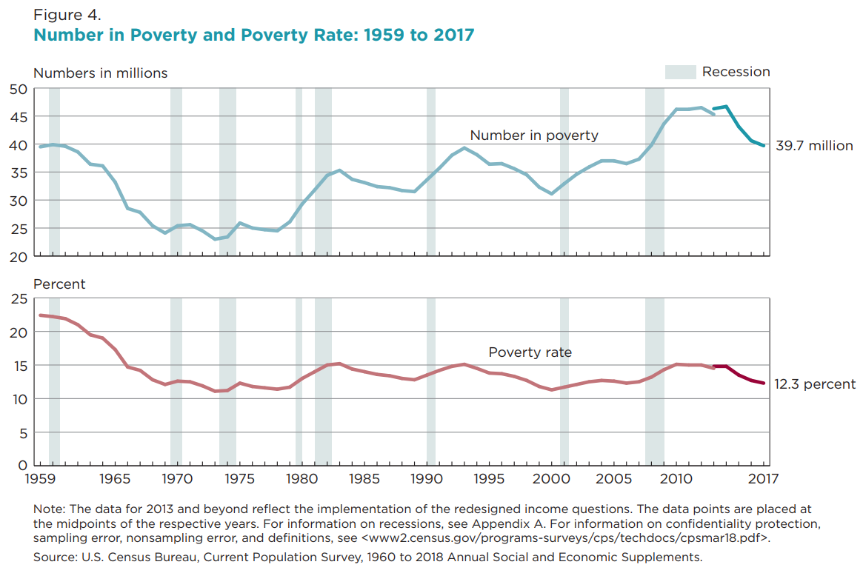
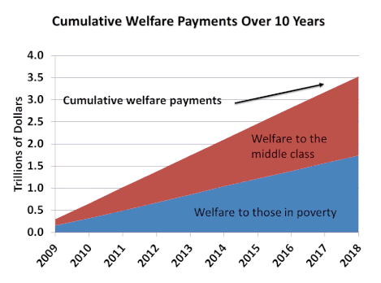
Poverty Numbers

Slide 5
Income Transfer Mechanism
Guaranteed income —100 percent phase out
“Negative income tax”—Guaranteed income with a phase out
Wage subsidy with no phase out
Wage subsidy with phase out
Categorical notches

Slide 6
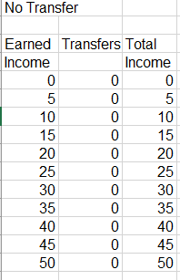
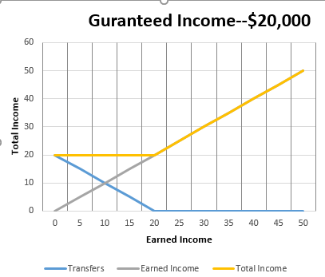
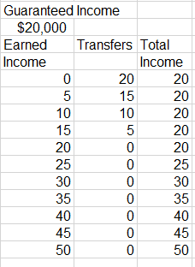
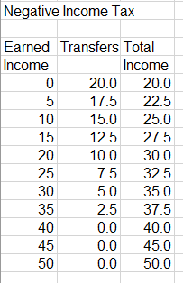
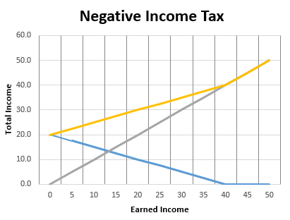
Income Transfer Options

Slide 7
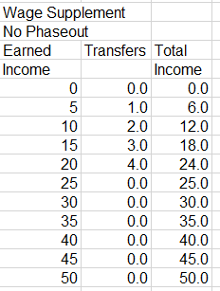
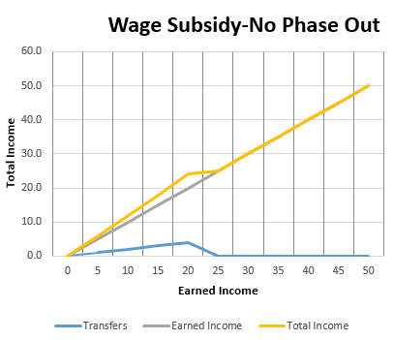
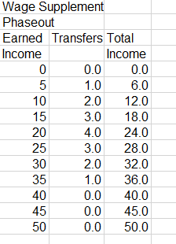
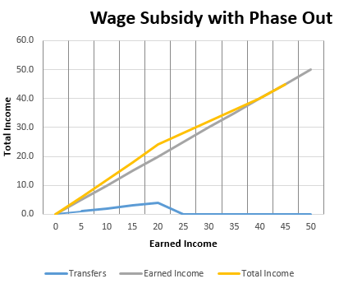
Income Transfer Options (continued)

Slide 8
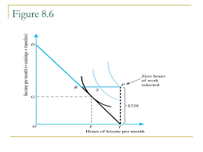
Impact on work effort
AFDC to TANF
Cash benefits for no more than 5 years
After two years, able bodies must work or take part in training
Block grants to states

Slide 9
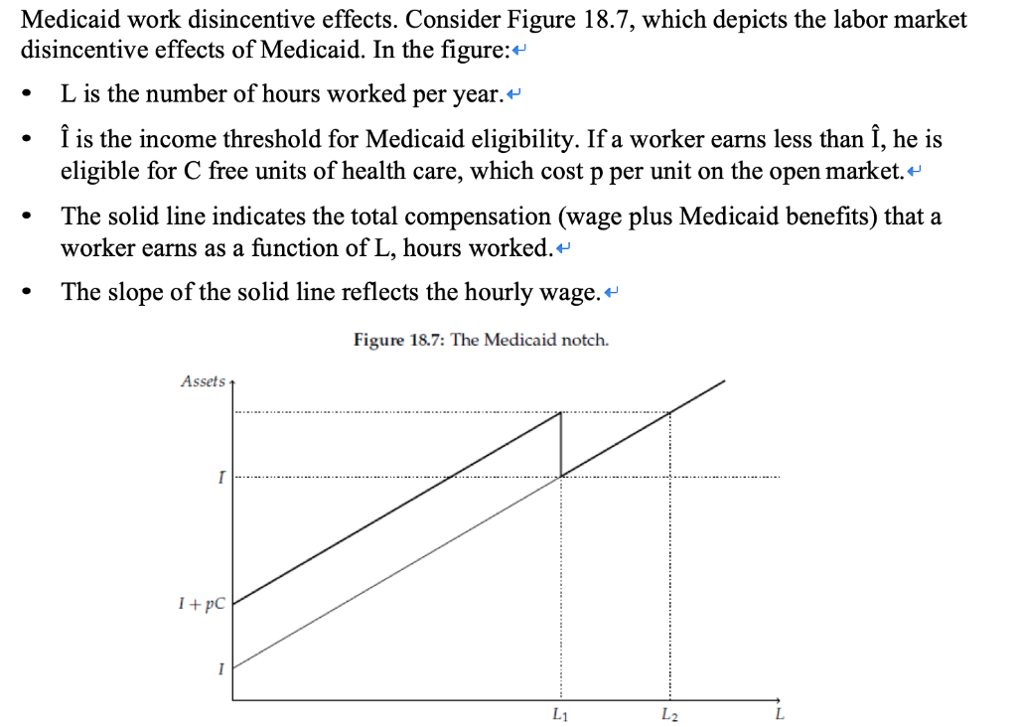
Notches—Not Phase with Categorical Programs

