Slide 1
ECON 411 Public Sector Economics PowerPoint Material 2020
J. Fred Giertz
Institute of Government and Public Affairs and Department of Economics
University of Illinois at Urbana
Online Lecture 3—March 26, 2020

Slide 2
Review of Redistribution
Motives
Private
Voluntary—individuals and charities
Pareto efficient
Self-interest of donor
Governmental--compulsory
Overcoming free-riding
Pareto-efficient reasons
Insurance motives
Downsian—power politics
Equity or efficiency issues
Market outcomes–good and bad

Slide 3
Transfer Issues
The cost of redistribution
Exhaustive vs. transfer
Impact of effort
Deserving vs. non-deserving
Poverty gap
Leaky bucket analogy
Paternalism
In-kind vs. cash transfers
Supplementable vs. non-supplementable transfer

Slide 4
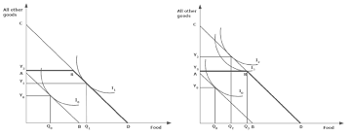
Cash vs. In-kind donations
From the recipients standpoint, cash transfers will always be and least as good and often better than an equal-valued in-kind transfer.
Food

Slide 5
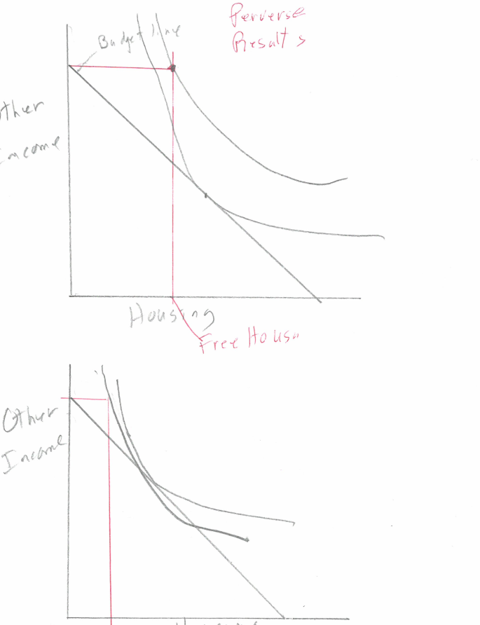
Non-supplementable transfers such as
housing and education
OTHER
iNCOME
Housing

Slide 6
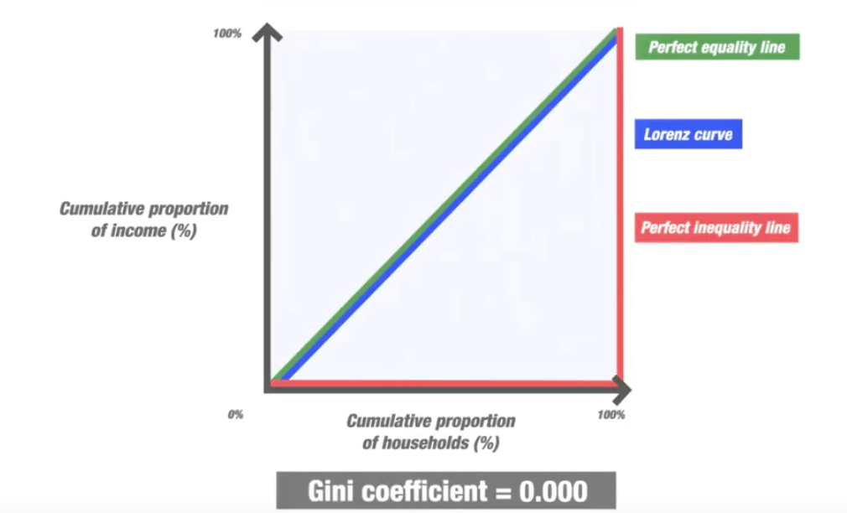
Measuring Inequality Lorenz Curve and Gini Coefficient

