Slide 1

ECON 411
Public Sector Economics
PowerPoint Material
2020
J. Fred Giertz
Institute of Government and Public Affairs and Department of Economics
University of Illinois at Urbana
Online Lecture 2—March 25, 2020

Slide 2
Possible Problems with Market
(What is the role government in a private enterprise economy?)
Preconditions for functioning market
  Property rights
  Enforcement of contracts
Philosophical issues
  Do consumers know what is best for them?
  Can consumers make “rational” choices?
Technical issues
  Public goods
  Externalities
  Incomplete Markets
  Imperfect information–Asymmetric information
  Distribution
  Monopoly
  Macro issues—stability and growth

Slide 3
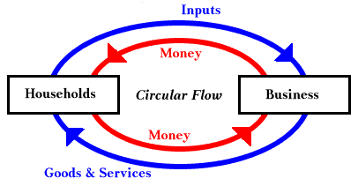

Slide 4
Redistribution—Basis issues
Equity or efficiency issues
Market outcomes–good and bad

Slide 5
Redistribution—Equity and Equality
Equality of outcomes or opportunity
Equality vs. Equity
1. Effort
Skill
3. Age profiles of earnings
4. Training and education
5. Non-pecuniary aspects of job
6. Efficiency–What would happen if equality was the goal

Slide 6
Redistribution and the Role of Government
The distribution of income
  Initial-Market-determines
  Secondary-redistribution
    Private
    Governmental
Evaluation of the income distribution
  Efficiency
  Equity

Slide 7
Motives for Redistribution
Private
  Voluntary—individuals and charities
  Pareto efficient
  Self-interest of donor
Governmental--compulsory
  Overcoming free-riding
  Pareto-efficient reasons
  Insurance motives
  Downsian—power politics

Slide 8
Transfer Issues
The cost of redistribution
  Exhaustive vs. transfer
  Impact of effort
    Deserving vs. non-deserving
    Poverty gap
    Leaky bucket analogy
Paternalism
In-kind vs. cash transfers
Supplementable vs. non-supplementable transfer

