Slide 1
ECON 411 Public Sector Economics PowerPoint Material 2020
J. Fred Giertz
Institute of Government and Public Affairs and Department of Economics
University of Illinois at Urbana
Online Lecture 15—April 19, 2020

Slide 2
Introduction to the Corporate Income Tax (and Related Issues of Business Taxation)
Business income is taxed under the individual income tax rules
Non-corporate net income (profit) flows directly into AGI
Corporate is taxed under a separate tax (the corporate tax) at the corporate level and then a portion of this income becomes part of AGI and is taxed at the individual level

Slide 3
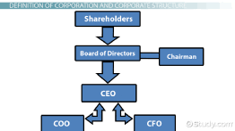
What is a corporation? (Sole proprietorships,
Partnerships, corporations, hybrids)
Limited liability
Rationale for taxation of corporations
Avoiding taxing individuals??
Two Views
Absolutist--benefits-based tax reflecting advantage of corporate form
Integrationist—dealing with shortcomings of the individual income tax
Which rationale applies to U. S.?
Treatment of dividends and retrained earnings

Slide 4
Corporate Taxation--Basics
Tax base: Net income = Revenue- Costs
Economic profit vs. accounting profit
Tax rates—progressivity?
Interest deductible, but dividends not-- Debt vs. equity
Dividends vs. retained earnings—double taxation issues Depreciation and expensing issues
Multi-jurisdiction issues—Worldwide vs. territorial

Slide 5
Depreciation
Discount rate = 10%
MTR = 34%

Slide 6
The Incidence of the Corporate Tax
Is corporate profit economic profit?
Two approaches
Excise approach
Burden distributed as if a excise tax on corporate sales
Regressive
General equilibrium approach (Harberger)
Impact lowers rate of return on all (not just corporate capital
Progressive

Slide 7
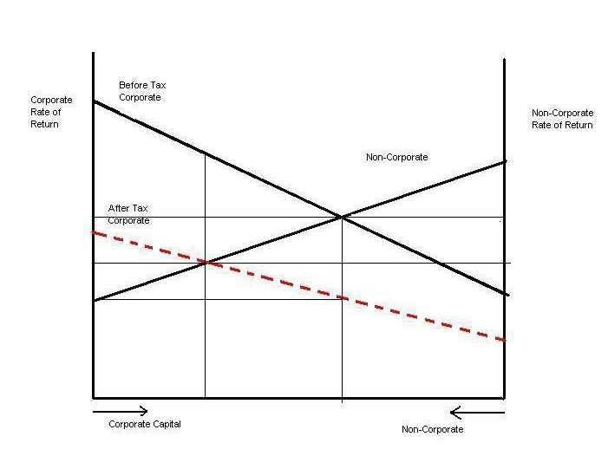
General Equilibrium Approach (Simplified)

Slide 8
General Equilibrium Approach (Simplified)

Slide 9
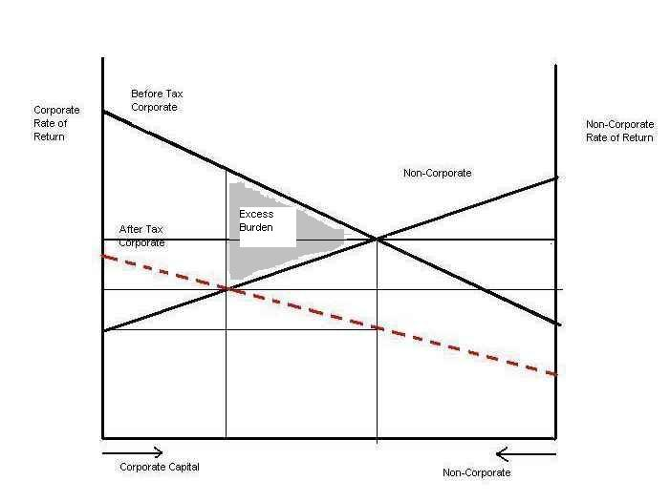
Excess Burden Analysis

Slide 10
General Equilibrium Results
Tax is borne by the owners of all capital
Tax is progressive
Tax creates excess burden
Tax reduces corporate investment and may reduce overall investment
User cost of capital increases
Tax may reduce slightly rate of economic growth

Slide 11
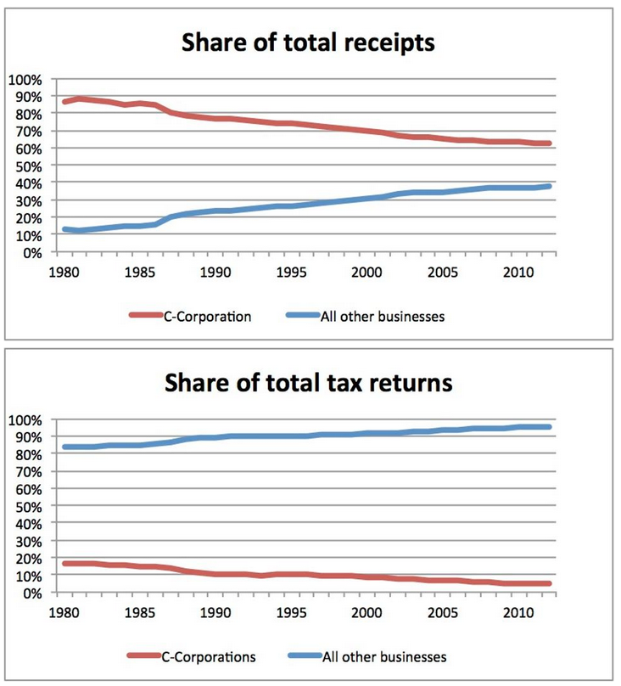
Corporate Issues: The Decline of Corporate Taxes
https://www.forbes.com/sites/modeledbehavior/2016/05/08/the-decline-of-corporations/#13f608ca4431

Slide 12
Reasons
Alternatives to corporate structure
“Tax Planning”
Domestic
International
Income and cost shifting
Transfer pricing

Slide 13
Tax Planning High to low rates
Between jurisdictions
Between taxpaying entities
People
Other entities
Between different types of income
Between time periods

Slide 14
International Issues
Tax Planning
Transfer pricing
Earnings Stripping—borrowing as substitute for repatriation (interest deductions, etc.
Check the box
Cross crediting
Territorial vs. worldwide taxation
Foreign credit
Repatriation
Inversions, etc
Losing economic activity vs. losing tax revenue

Slide 15
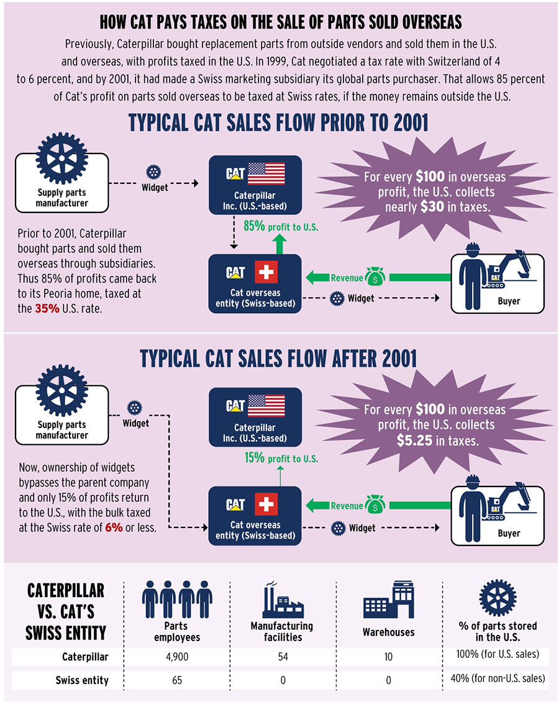

Slide 17
