Slide 1
ECON 411 Public Sector Economics PowerPoint Material 2020
J. Fred Giertz
Institute of Government and Public Affairs and Department of Economics
University of Illinois at Urbana
Online Lecture 13—April 17, 2020

Slide 2
Taxation--Plan
Introduction to basic definitions and concepts
Taxes defined
Equity and efficiency in taxation
Basis for allocating tax burden
Tax rates
Measuring tax burdens
Economic impact of taxes
The analysis of important taxes
Income taxes
Business taxes
Consumption taxes
Wealth taxes

Slide 3
Basis for Taxation
Ability-to-pay (economic capacity)
Consumption
Benefits-received
Base related to usage, e. g., motor fuels
Wealth
Property tax
Death and gift taxes
Sales and VA taxes
Broad-based consumption taxes
Income

Slide 4
Individual Income Taxation
Definition of income
Measure of ability-to-pay
Haig-Simons, Accretion concept, Comprehensive Income, Economic income
“Income may be defined as the algebraic sum of the market value of rights exercised in consumption plus the change in value of the store of property rights between the beginning and end of the period in question.” Simons
Income = Consumption + Change in Wealth

Slide 5
Individual Income Taxation (continued)
Other definitions
Legal (AGI)
Income as production
Income vs. consumption (a first look)
Income = Consumption + Saving
Income – Consumption = Saving
The issue is the tax treatment of savings

Slide 6
The U. S. Income Tax--Step by step
Is income alone enough to determine ability to pay?
Other factors
Family size
Unavoidable expenses—health care, casualty losses, other taxes??
Age??
Incentives—charities, housing?
Comprehensive Income (Haig-Simons)
Exclusions
AGI
Exemptions and deductions
Taxable Income
Tax rates, filing status
Tax Liability (before and after credits)
Withholding, estimated payments
Final payment or refund

Slide 7
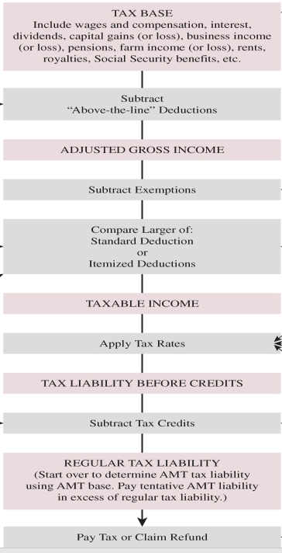

Slide 8
Rationale for Exemptions and Deductions
Credits, Deductions and Exemptions
Exemptions (ability-to-pay)
Deductions
Minimum standard
Itemized
Ability-to-pay
Health care costs
State and local taxes?
Casualty losses
Incentives
Charitable contributions
Mortgage interest
State and local taxes?

Slide 9
The U. S. Income Tax--Step by step
Comprehensive Income (Haig-Simons)
Exclusions
AGI
Exemptions and deductions
Taxable Income
Tax rates, filing status
Tax Liability (before and after credits)
Withholding, estimated payments
Final payment

Slide 10
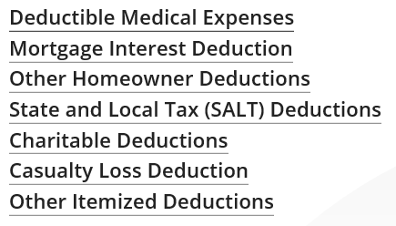
The U. S. Income Tax--Step by step
Deduction vs. Credit
Value of $100 credit if $100
Value of $100 deduction is MTR x $100 (value of a deduction increases with AGI)
Comprehensive Income (Haig-Simons)
Exclusions
AGI
Exemptions and deductions
Taxable Income
Tax rates, filing status
Tax Liability (before and after credits)
Withholding, estimated payments
Final payment
List of Itemized deductions
No income tax threshold
Married joint: $24,400
Single: $12,200

Slide 11
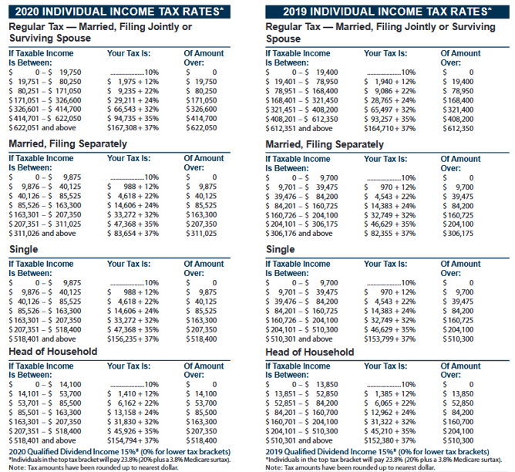
The U. S. Income Tax--Step by step
Comprehensive Income (Haig-Simons)
Exclusions
AGI
Exemptions and deductions
Taxable Income
Tax rates, filing status
Tax Liability (before and after credits)
Withholding, estimated payments
Final payment

Slide 12
The U. S. Income Tax--Step by step
Comprehensive Income (Haig-Simons)
Exclusions
AGI
Exemptions and deductions
Taxable Income
Tax rates, filing status
Tax Liability (before and after credits)
Withholding, estimated payments
Final payment or refund

Slide 13
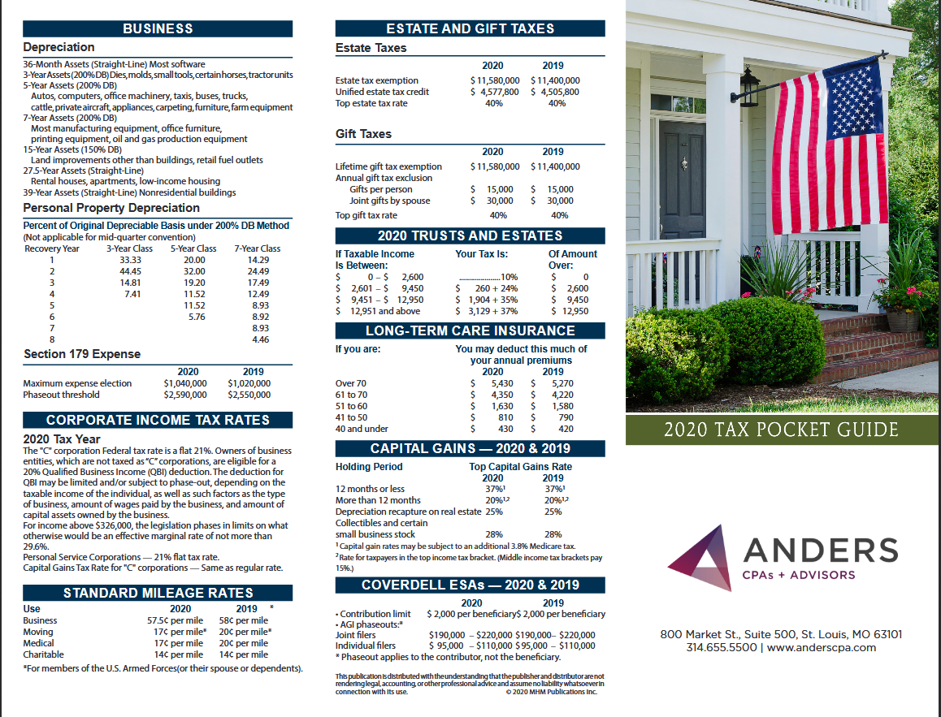

Slide 14
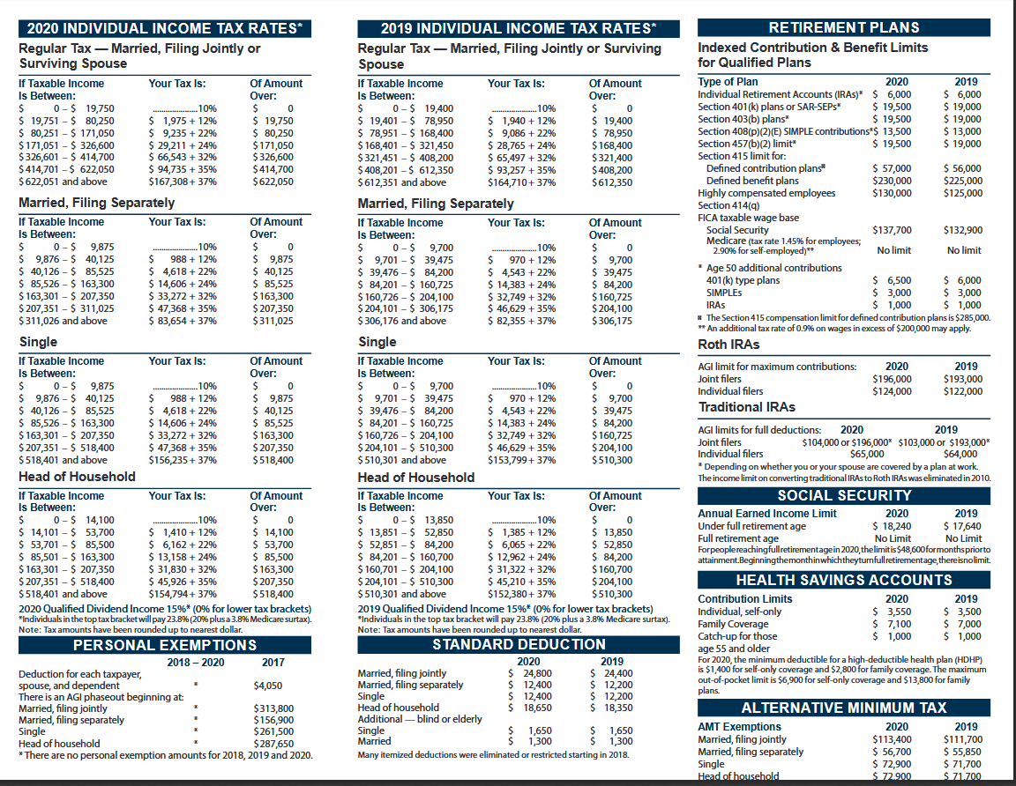

Slide 15
History of Income Taxation
Constitutional constraints—direct taxes apportioned among the states on basis of population
Property taxes
Income taxes
Early revenue—tariffs, sale of land, and some excises
Civil war income tax

Slide 16
History of Income Taxation
1894 income tax unconstitutional
State income taxes in early 20th century
16th amendment—1913
First modern income tax—1913
Wars and the depression
High nominal marginal rates and narrow base
1980s onward

Slide 17
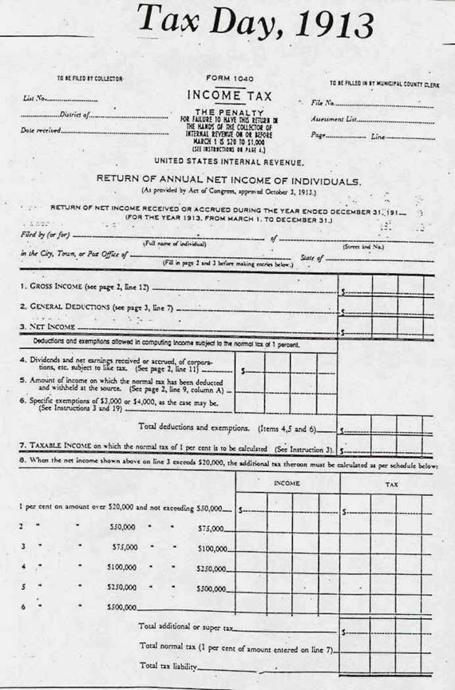

Slide 19
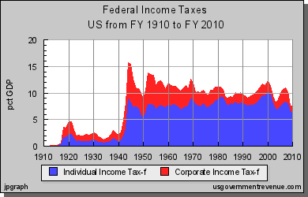

Slide 20
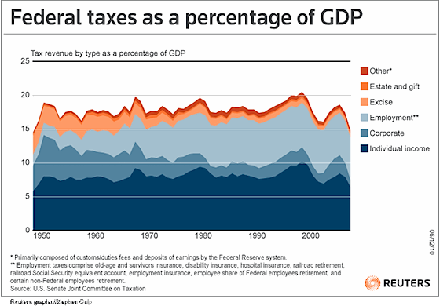

Slide 22
Individual Income Tax Topics--Preview
Inflation
Bracket creep
Taxation of income from capital
Tax treatment of family—equity on various fronts
Reasons for joint filing
Marriage penalty and rewards
Income averaging
Housing (r-m-d)

