Slide 1

ECON 411
Public Sector Economics
PowerPoint Material
2020
J. Fred Giertz
Institute of Government and Public Affairs and Department of Economics
University of Illinois at Urbana
Online Lecture 1—March 24, 2020

Slide 2
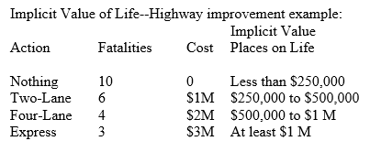
Benefit Cost Analysis
Specify objectives--benefits and costs
Measure output and costs in physical terms
Place a dollar value on b & c.
Compare with alternatives (discounting)

Slide 3
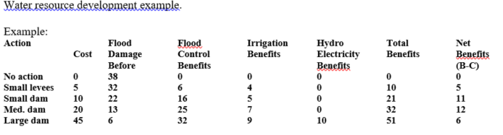
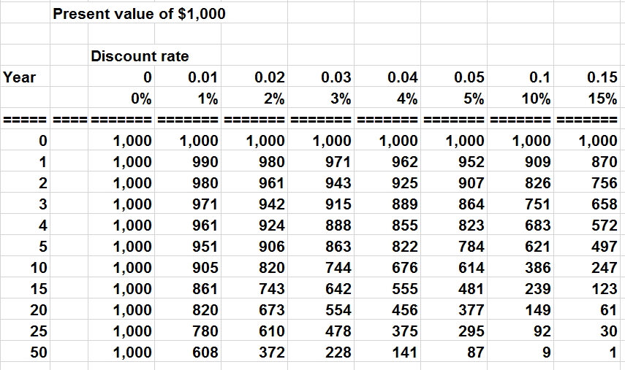
Benefit Cost Example

Slide 4
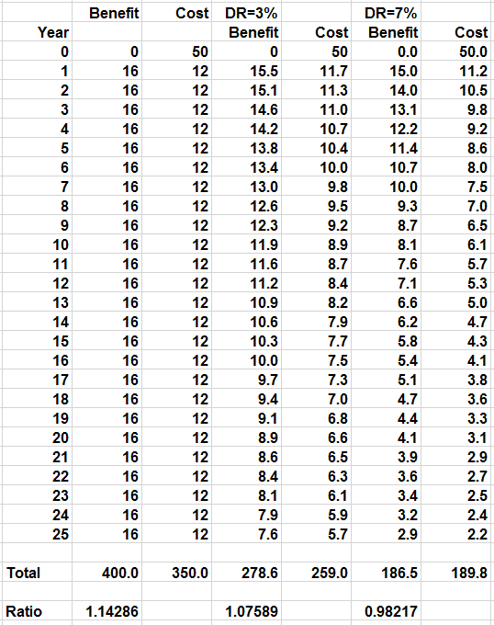
Importance of Discounting
Choosing a discount rate-opportunity cost of resources withdrawn from private sector
Consumption—interest paid on savings (non-consumption)
Investment—rate of return on invested capital

Slide 5
Cost-Benefit Analysis and Inflation
Real and nominal interest rates
i(nominal)= i(real) + expected inflation
Options—either use
  Current values (non-inflated) for benefits and costs with a real interest rate or
  Nominal values (inflated) for benefits and costs with a nominal interest rate

